Slide 1


Tableau Prep Builder and Tableau Desktop Project

Slide 2
Submitted by
Mohammad Monjur-E-Elahi
Course: Tableau for Data Analytics [DSA11]
Program: Data Science and Application - Advanced Diploma [6060]
Metro College of Technology
Date: 15 July, 2021

Slide 3
The Project for Tableau Prep
We’ve been given a folder of excel/csv files by an Upcoming School containing :
School Level Data:
Plans for High School Graduates
Student SAT scores
Educator Evaluation Performance
Teacher Data
District Level Data:
Per Pupil Expenditure
Advance Course Completion Repo
Teachers Salary

Slide 4
The Project for Tableau Prep
We are asked to focus only on:
4 Year Public College
4 Year Private Colleges
Number of teachers should be more than 50
Hull – High School needs to be excluded as outlier
District Springfield will be excluded due to inaccuracy in the data
Used Tableau Prep to:
• Connect to multiple data sources
• Examine and filter the data
• Clean and shape fields
• Combine and aggregate data
• Share and update curated data sources

Slide 5
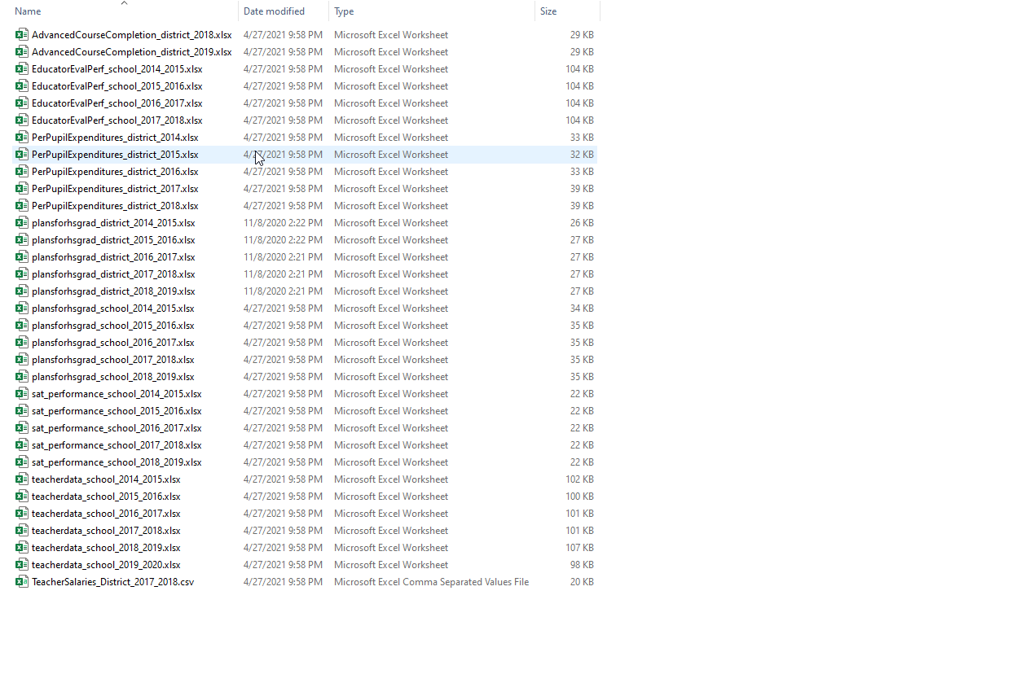
Content of the Folder
4 Sets School
3 Sets District
DATA

Slide 6
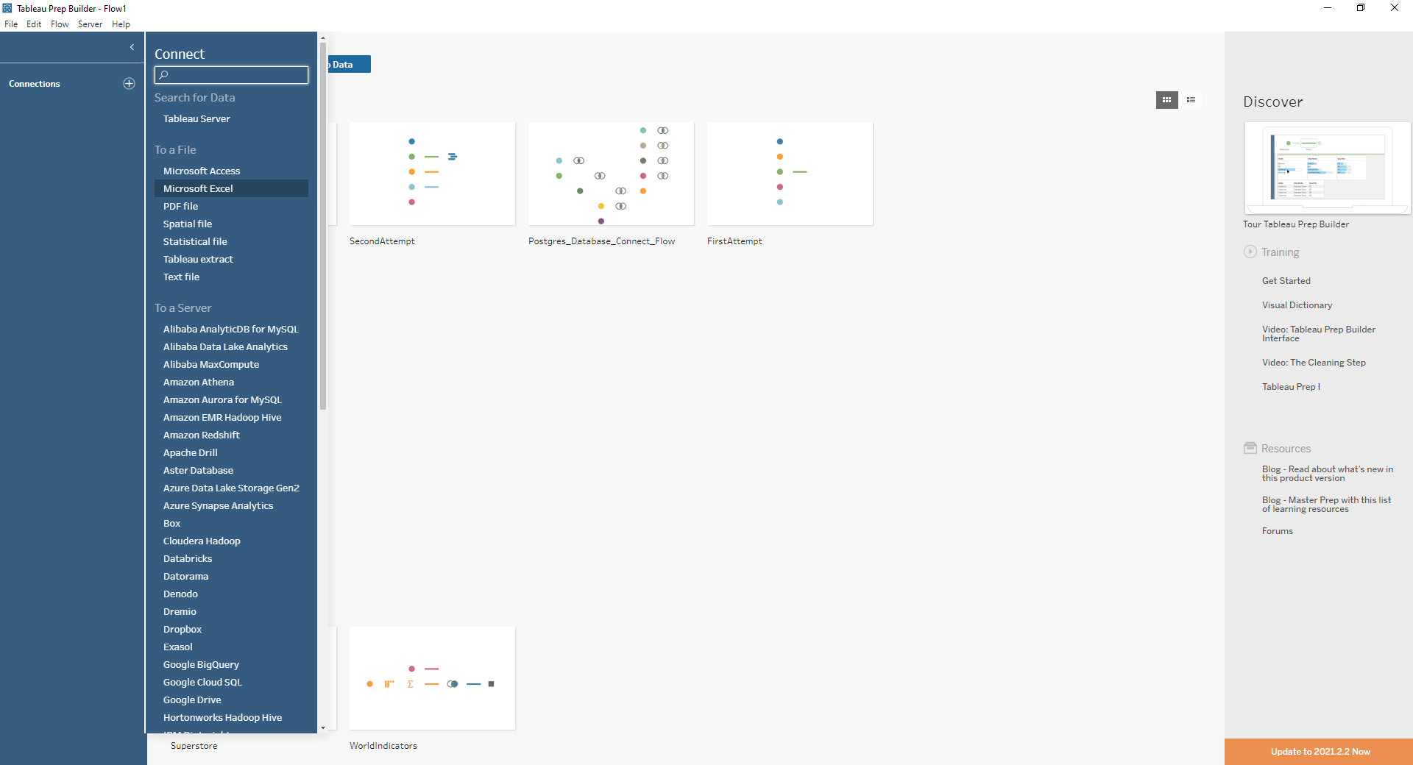
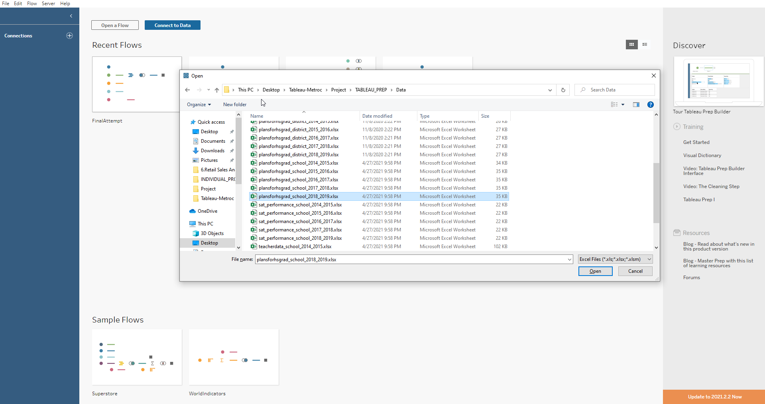
Excel files as input
1
2

Slide 7
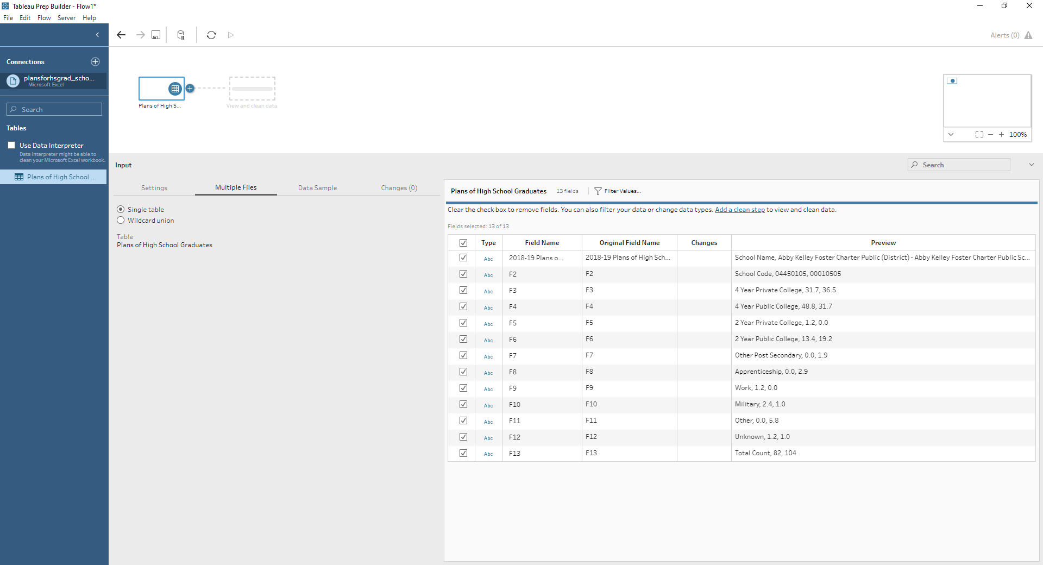
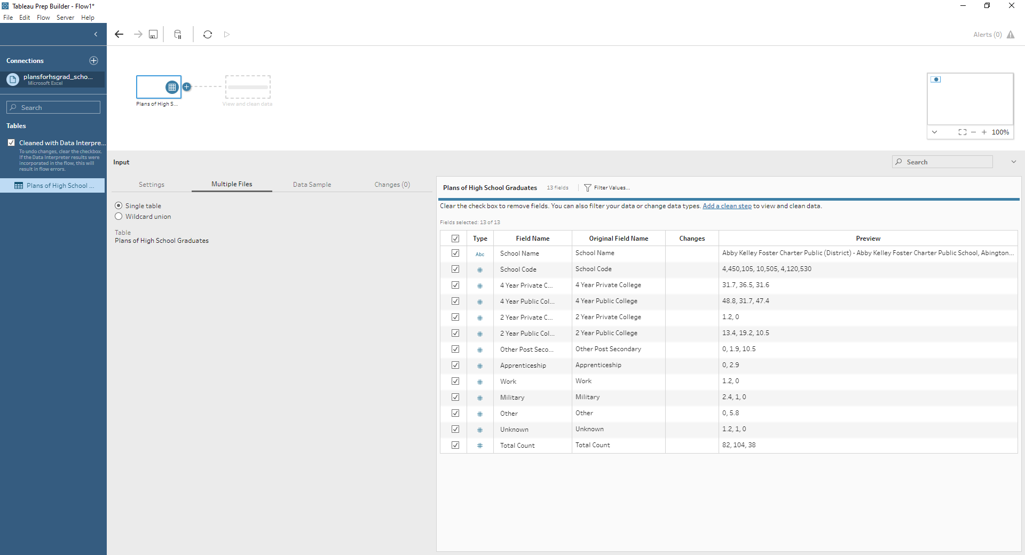
Data Not Read Correctly. Fixed with Data Interpreter
1
2

Slide 8
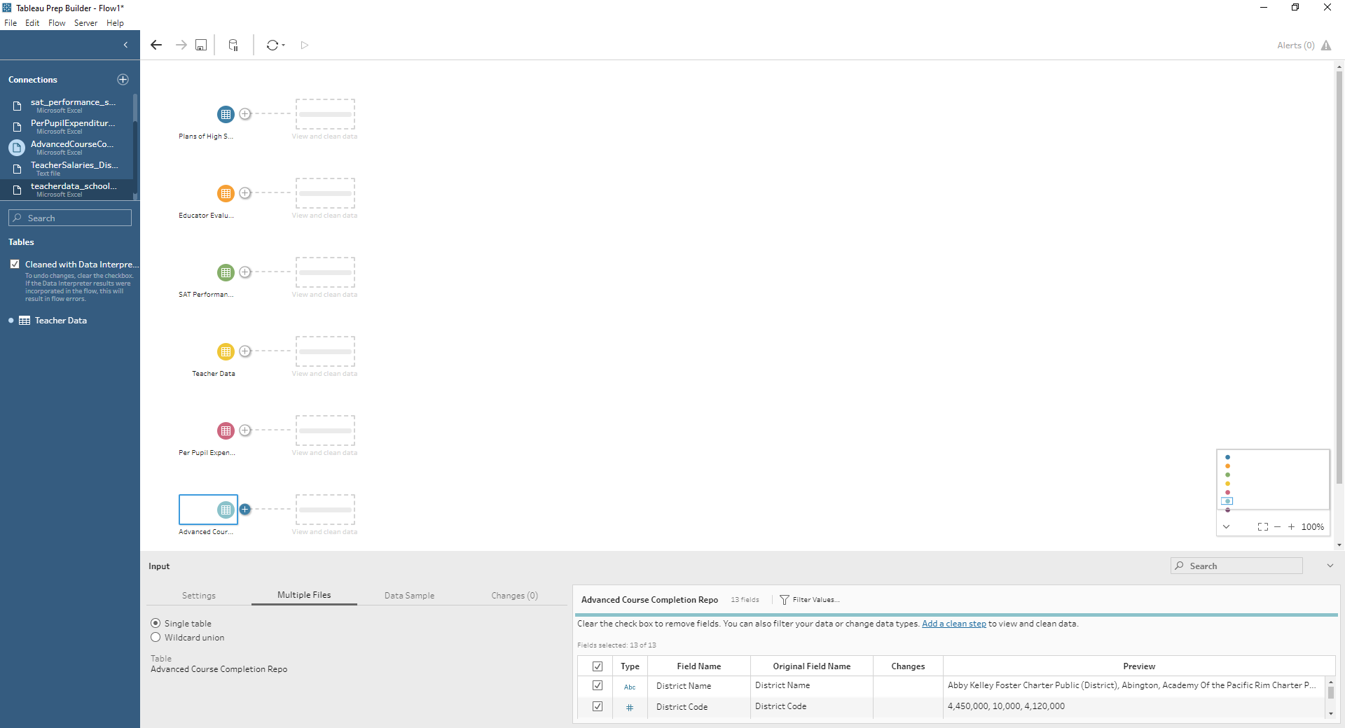
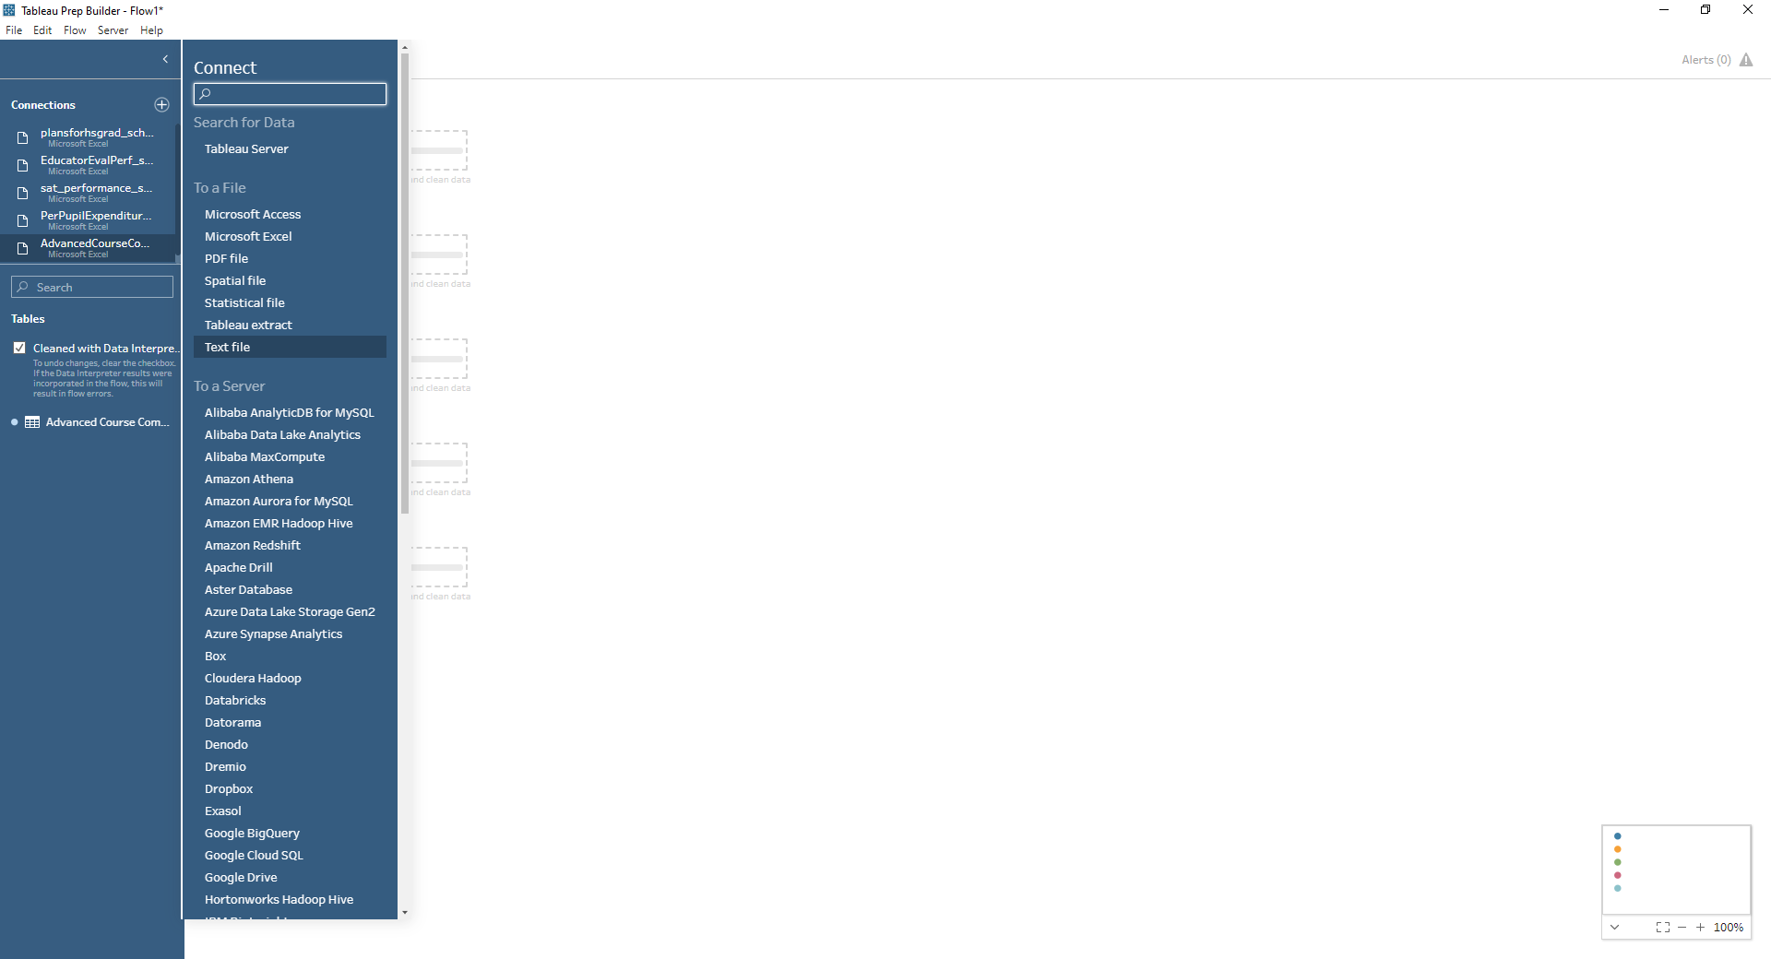
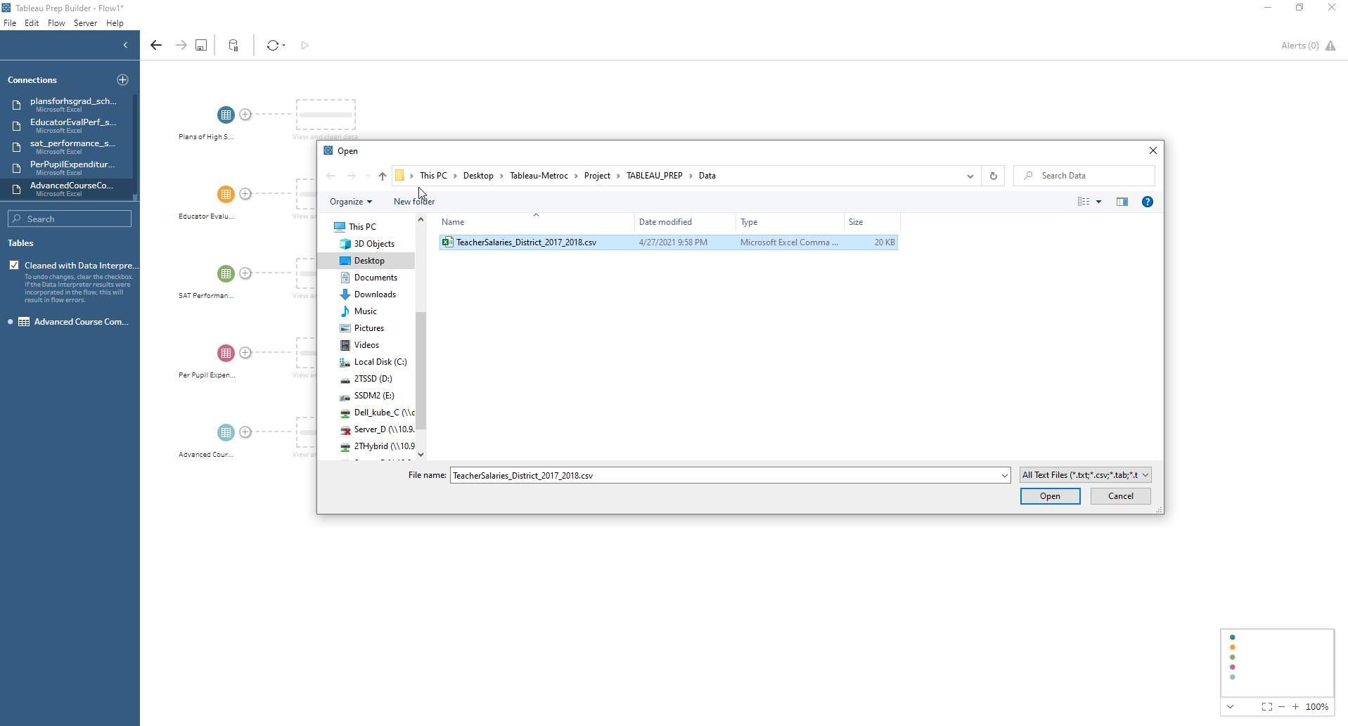
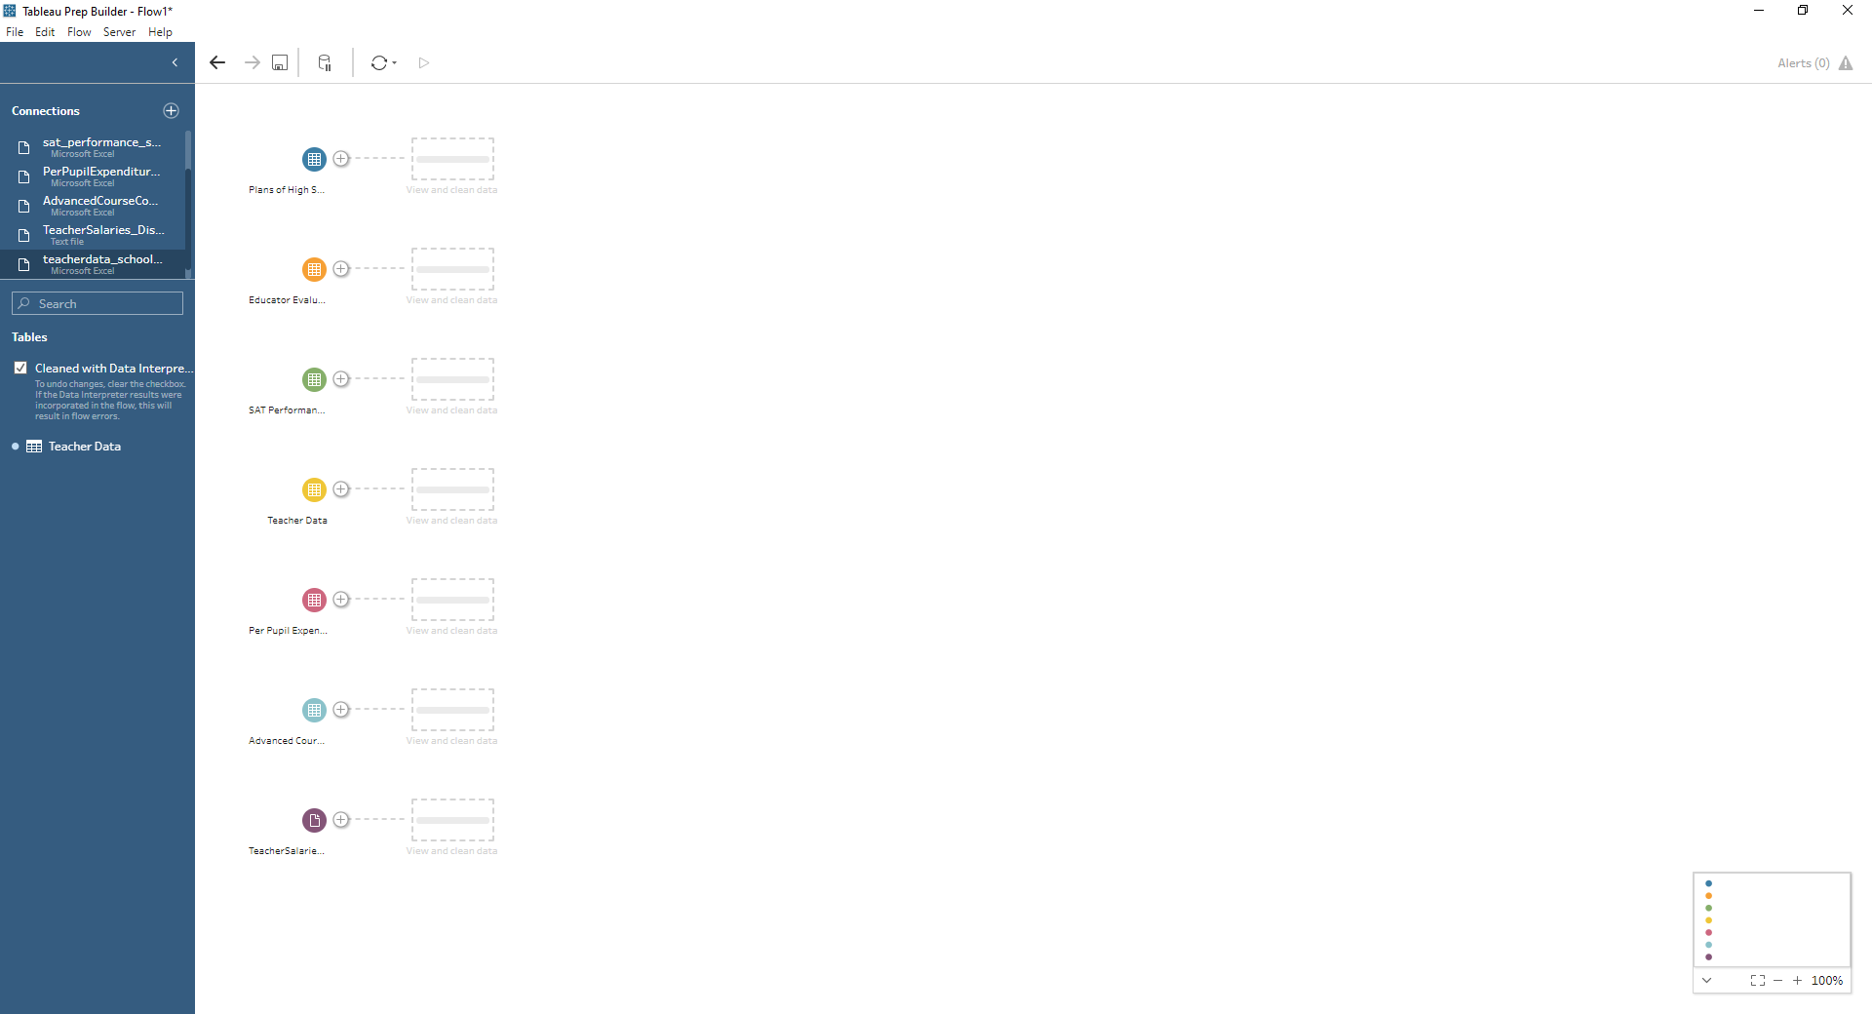
One Excel File from Other Group of Files and .csv File inserted
1
2
3
4

Slide 9
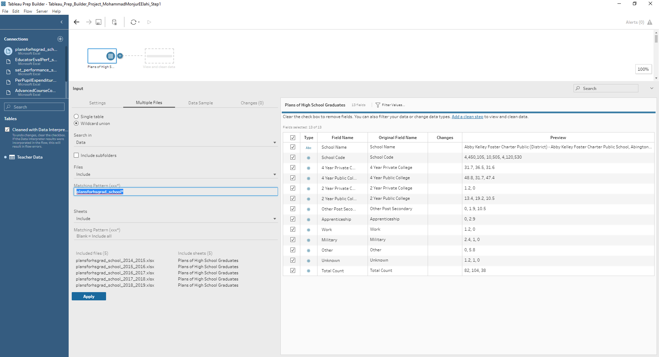
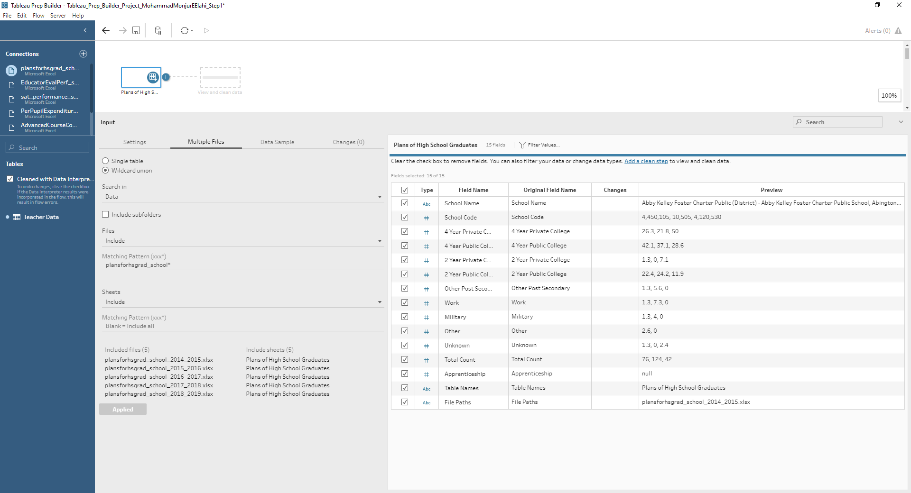
Wild Card Union for plansforhsgrad_school
1
2

Slide 10
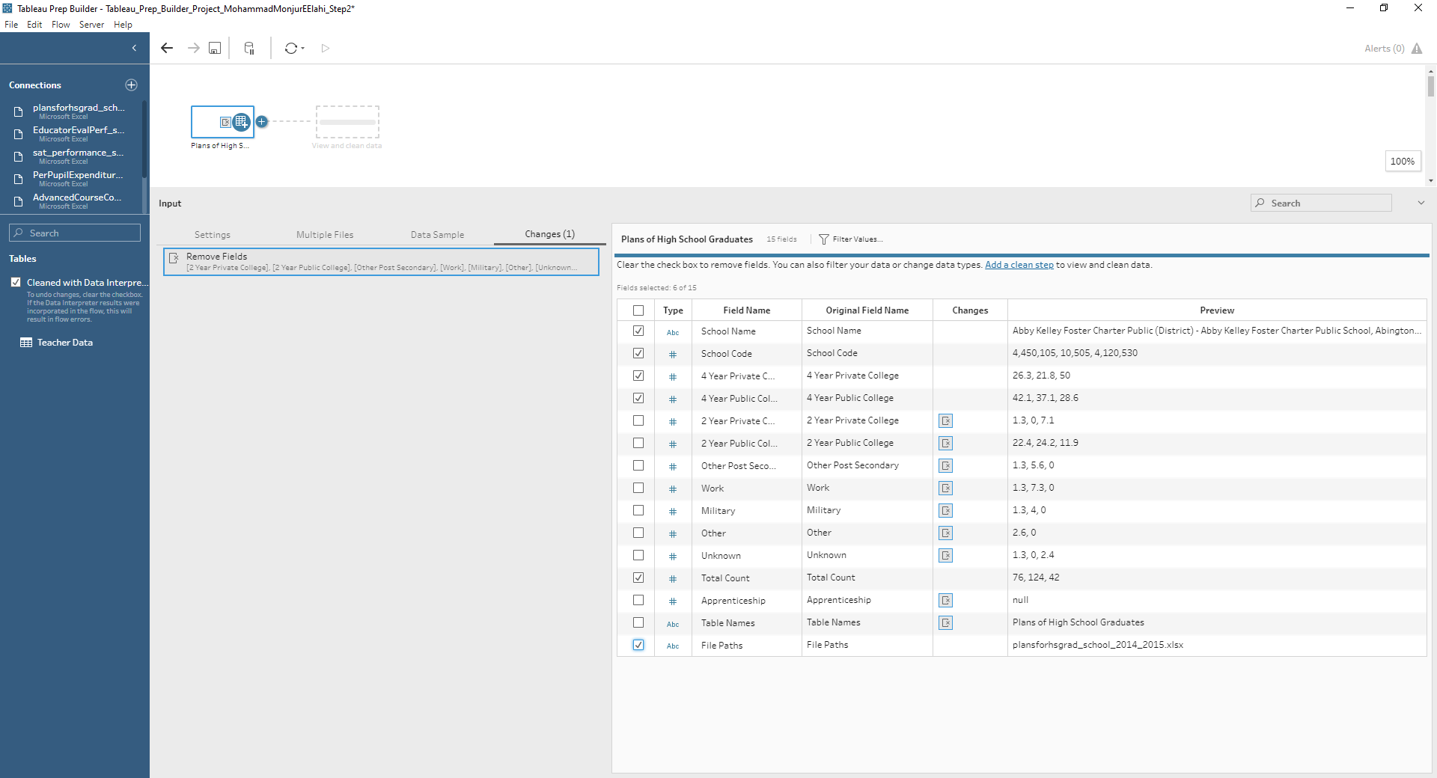
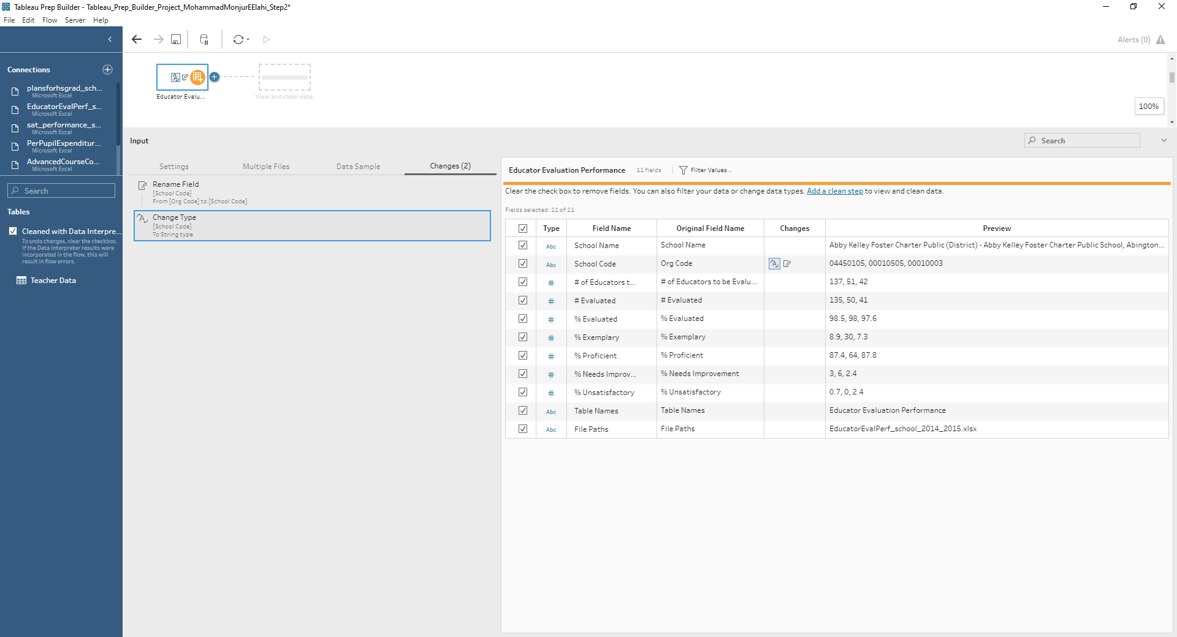
Removing Unwanted Fields, renaming fields & Changing Data Type
1
2

Slide 11
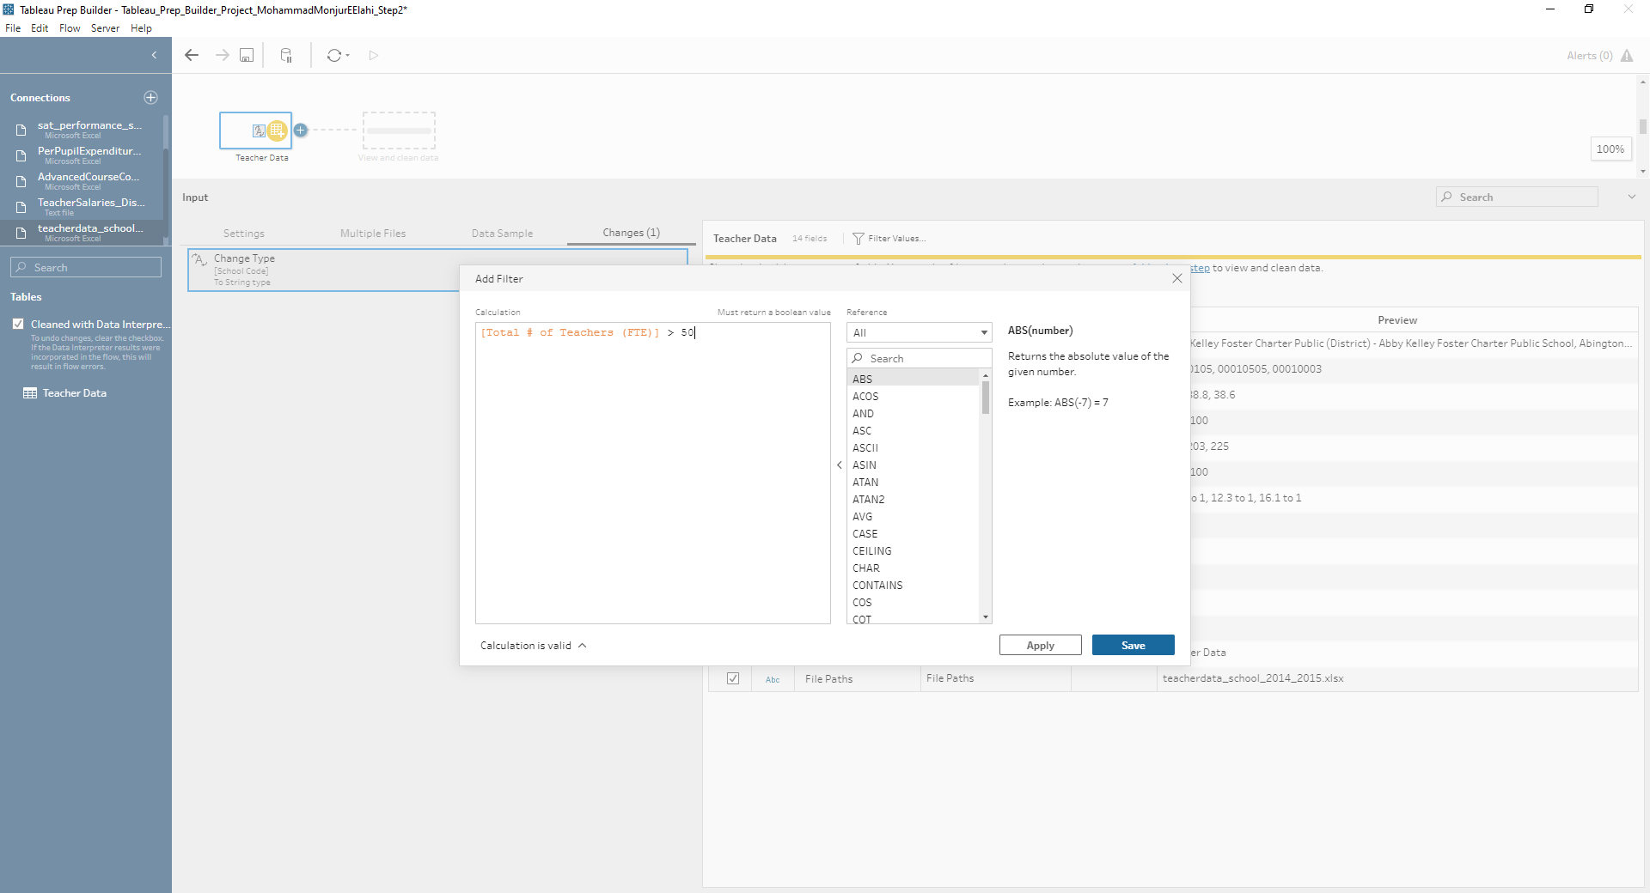
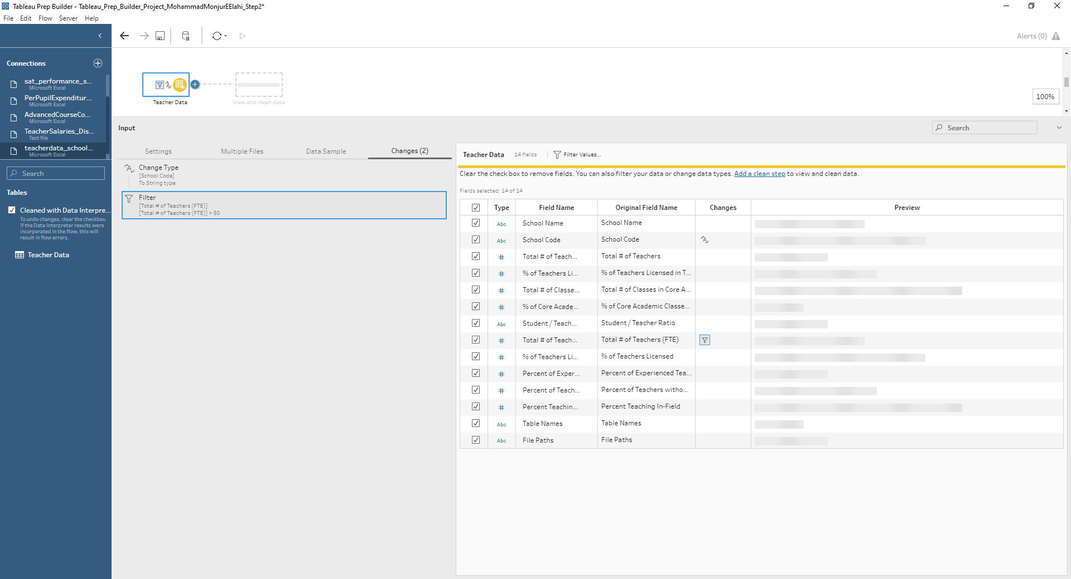
Input Filter – As per client specification – School with 50+ Teachers
1
2

Slide 12
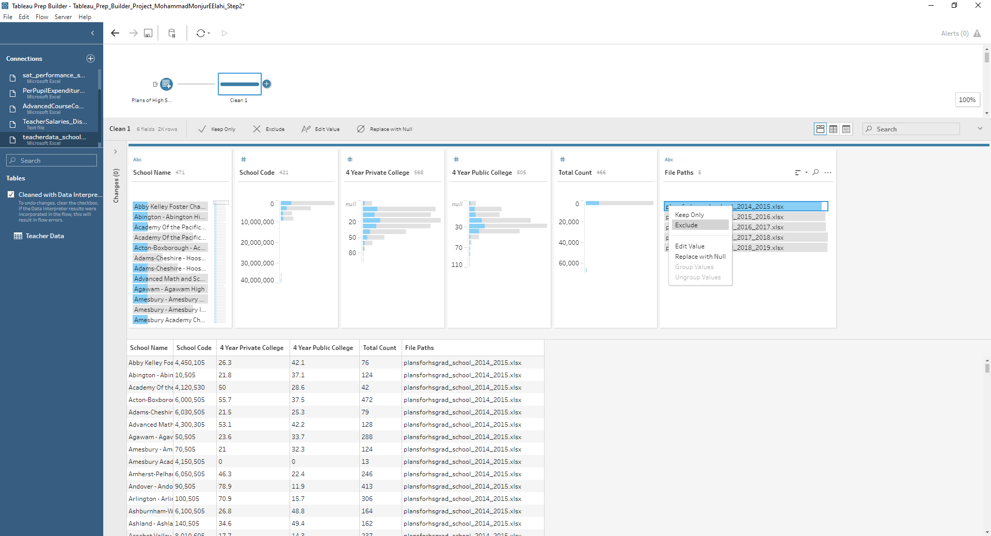
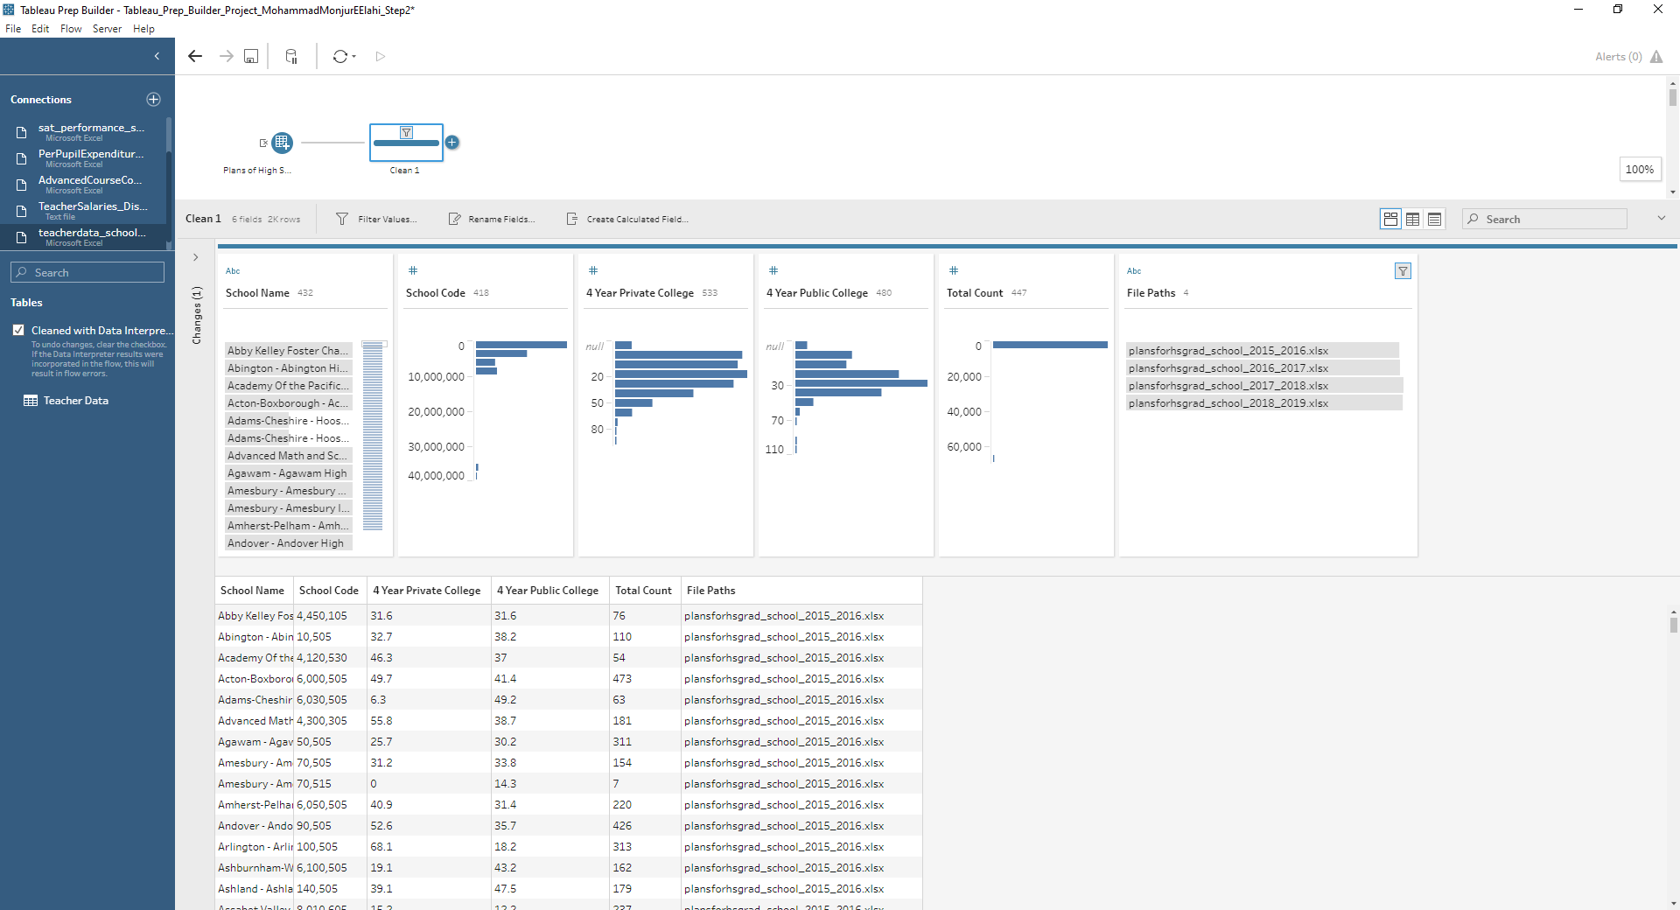
Filtering Out Irrelevant Data File – Too old as per client
1
2

Slide 13
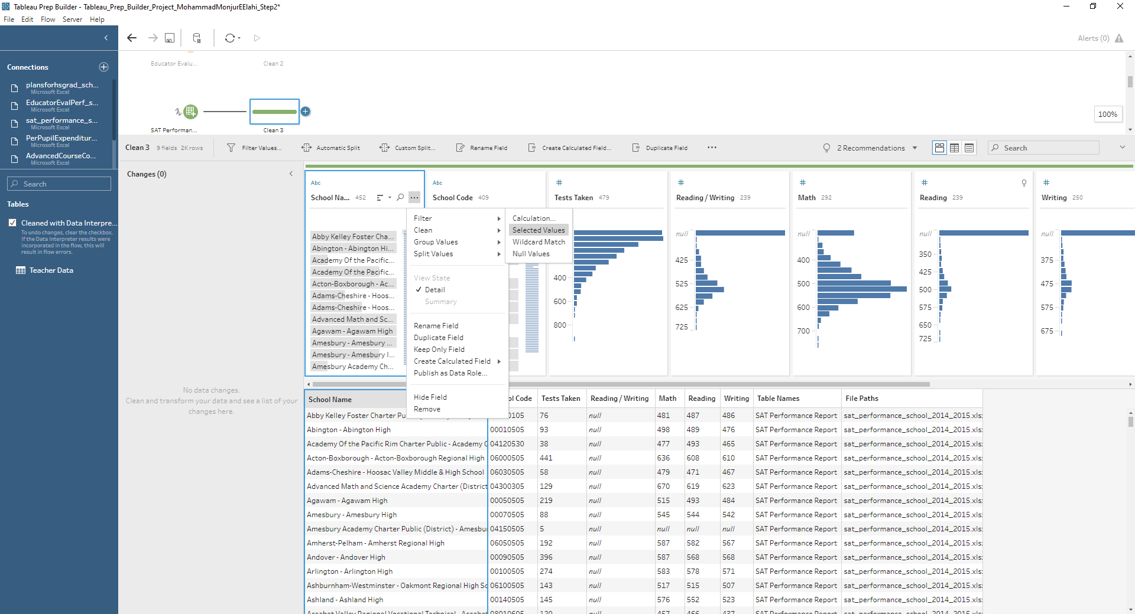
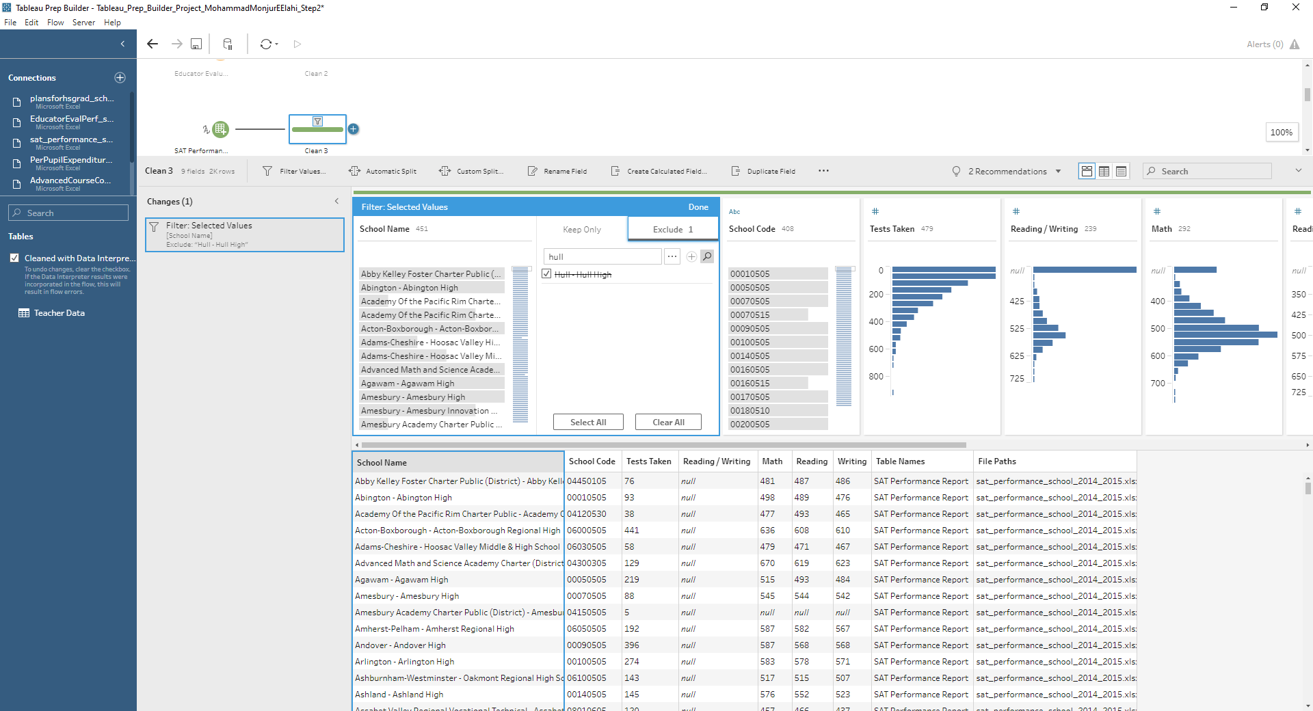
Exclude One Outlier School
1
2

Slide 14
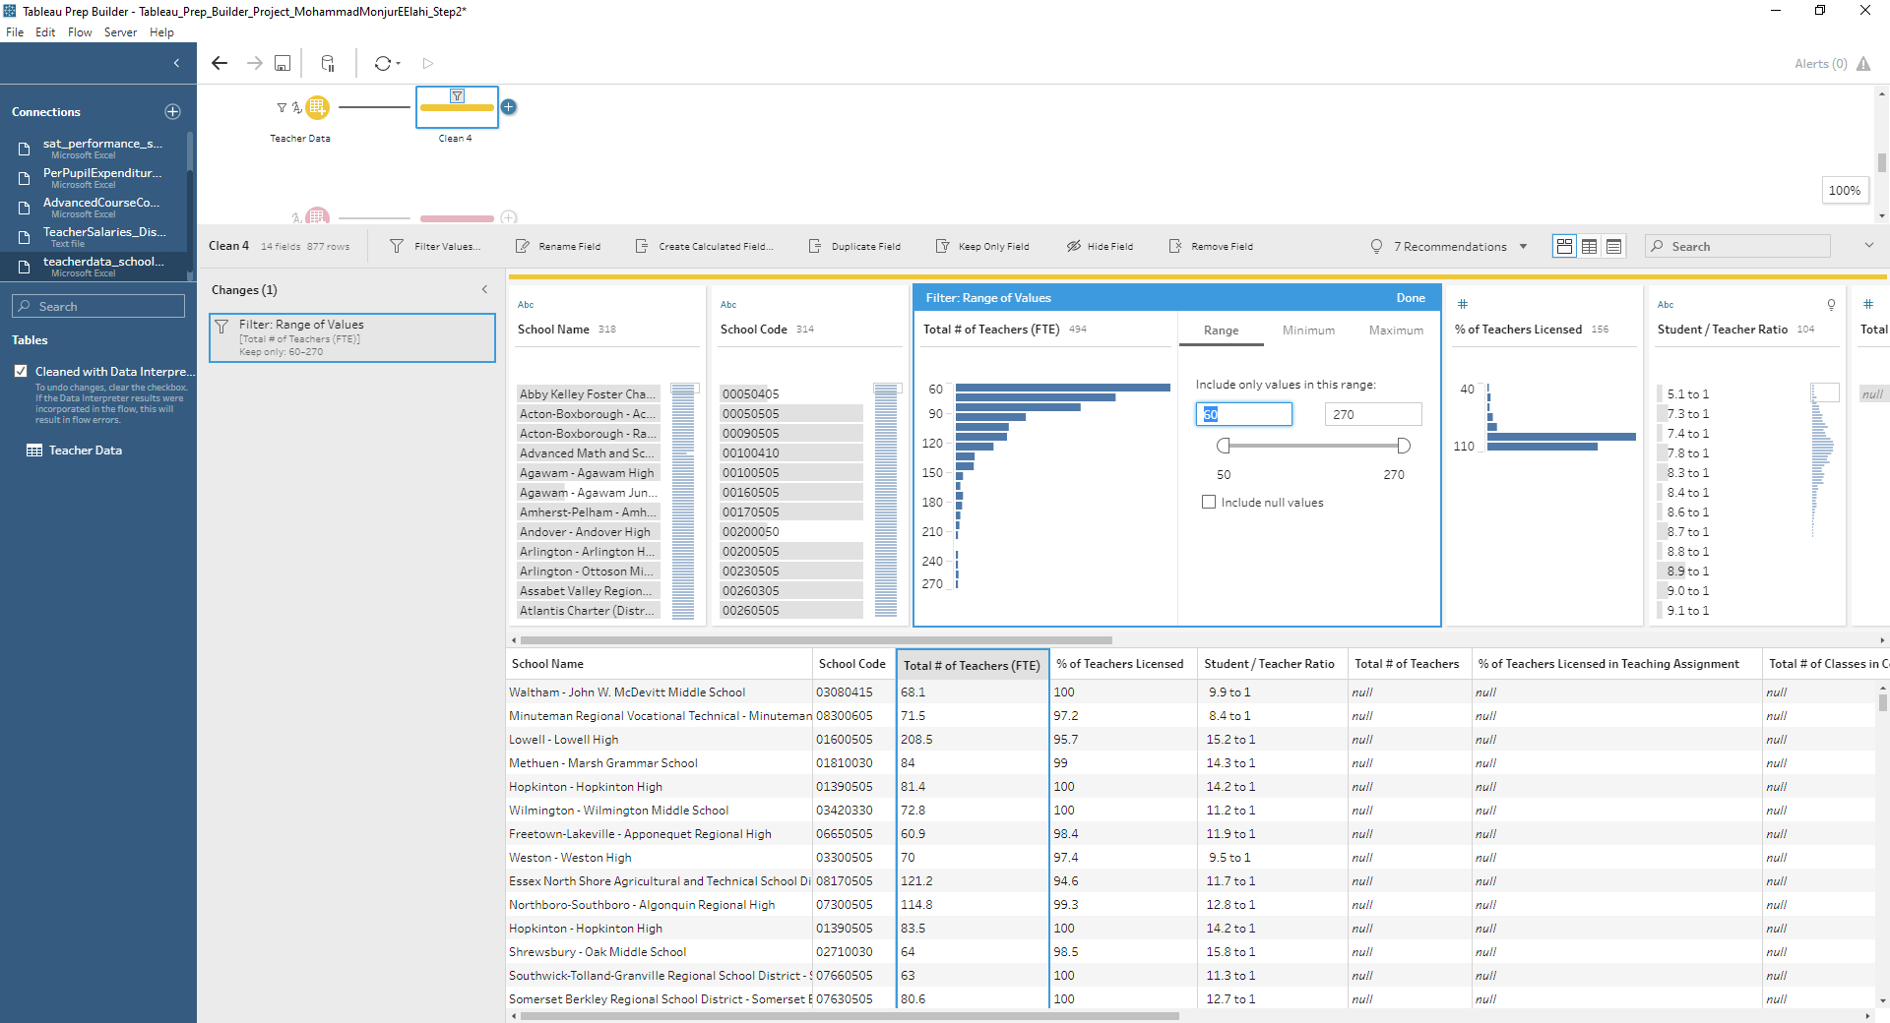
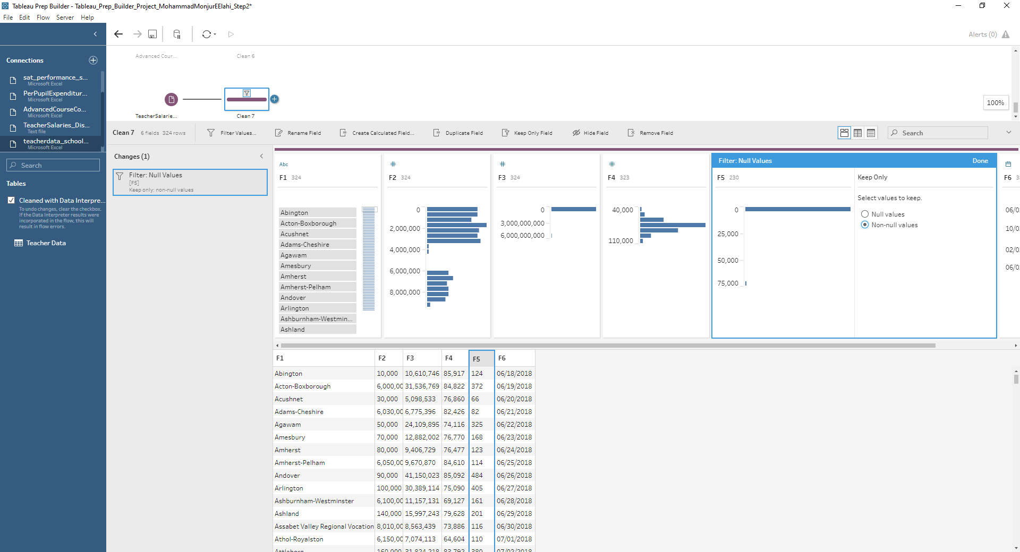
Adjust the range of teachers and removing null values from salaries
1
2

Slide 15
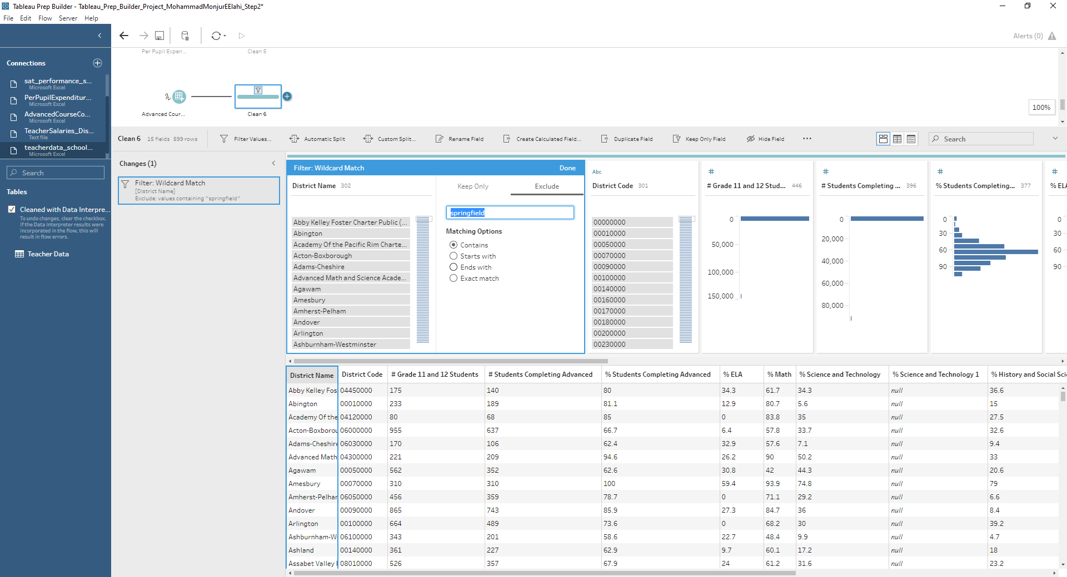
Springfield district data will be excluded due to inaccuracy

Slide 16
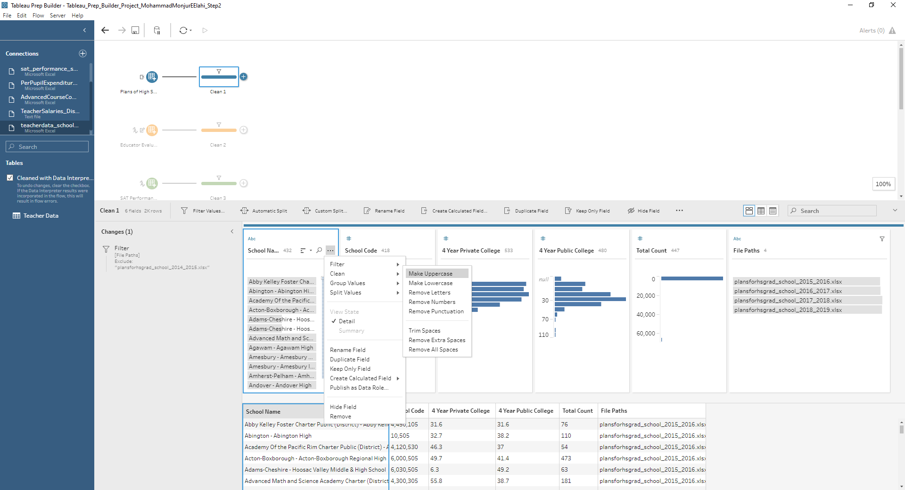
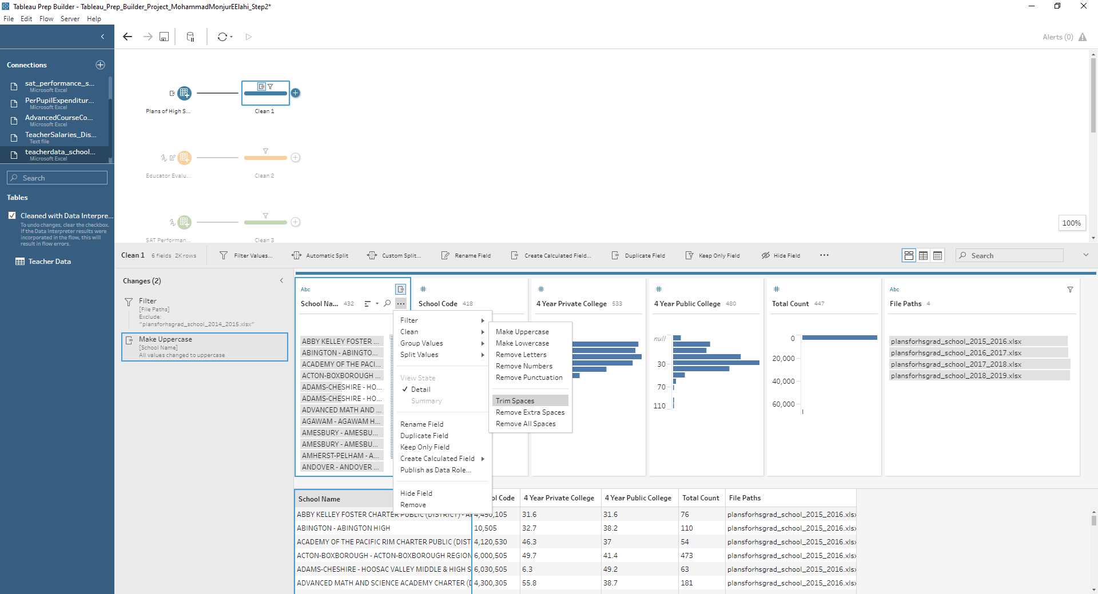
School Name, District Name Uppercase and space trimmed
1
2

Slide 17
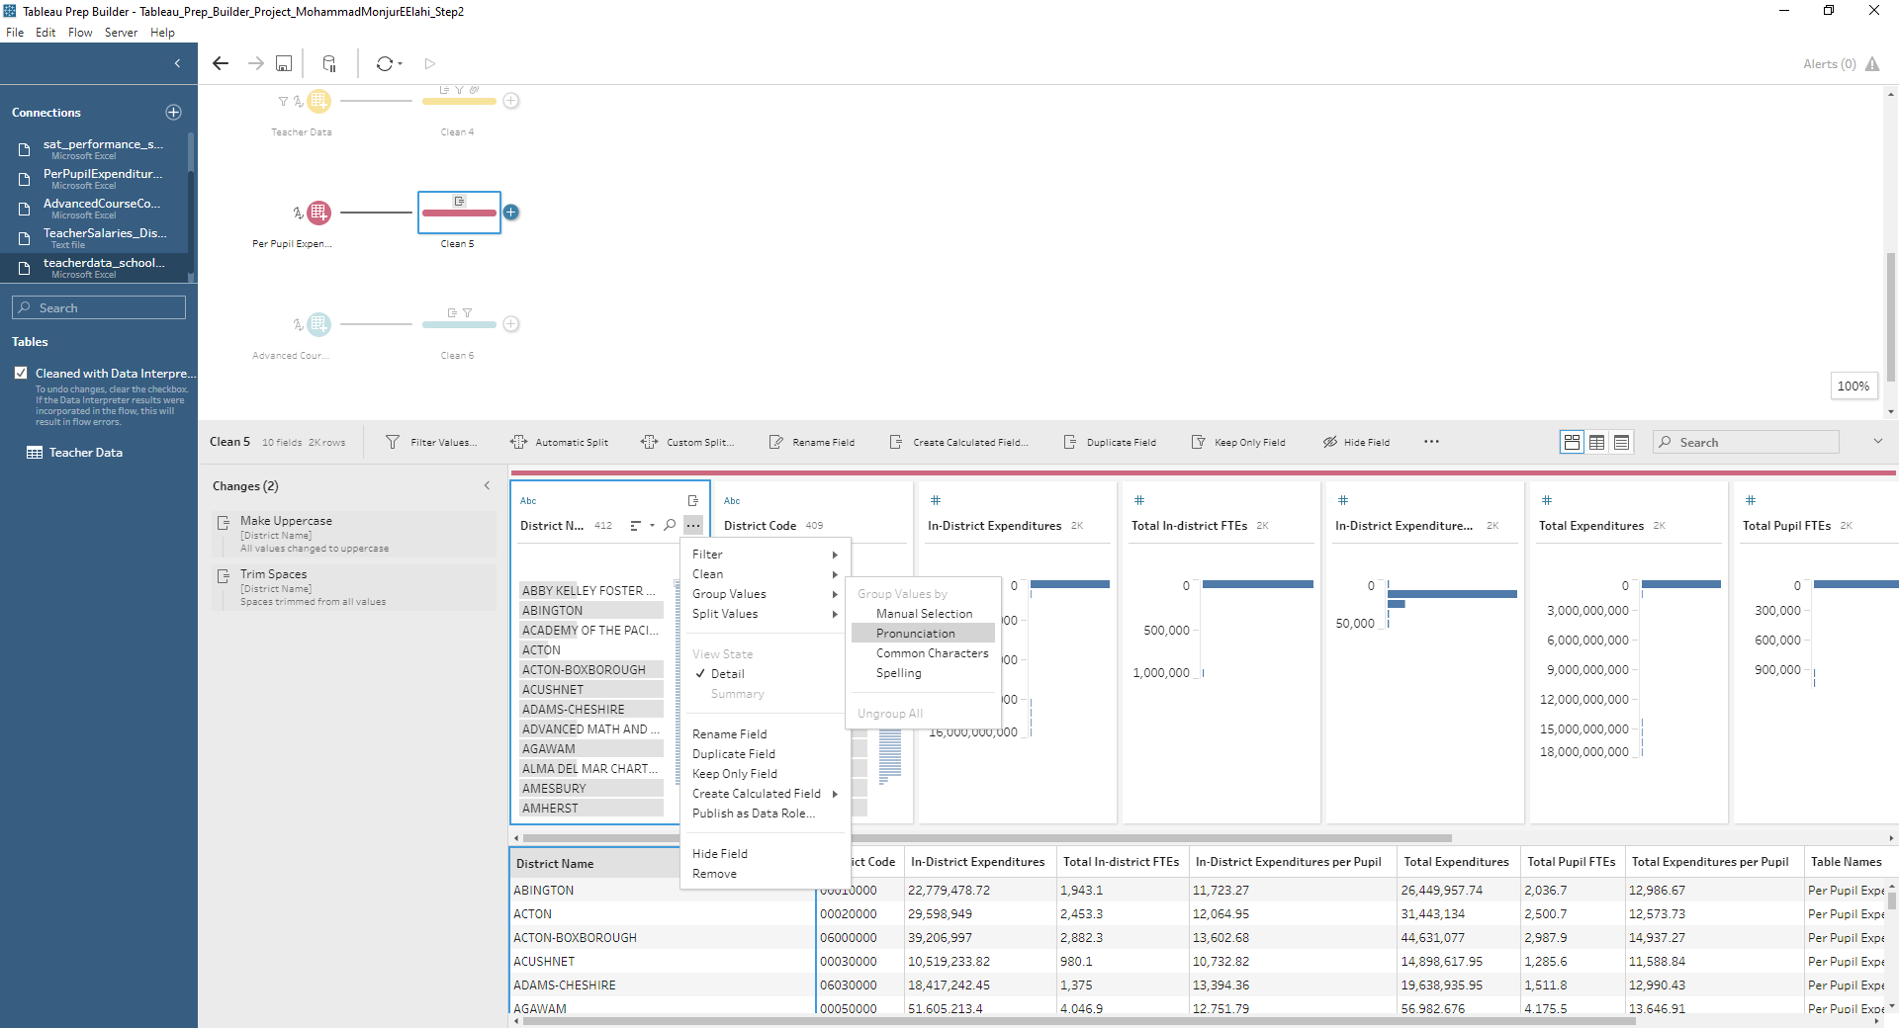
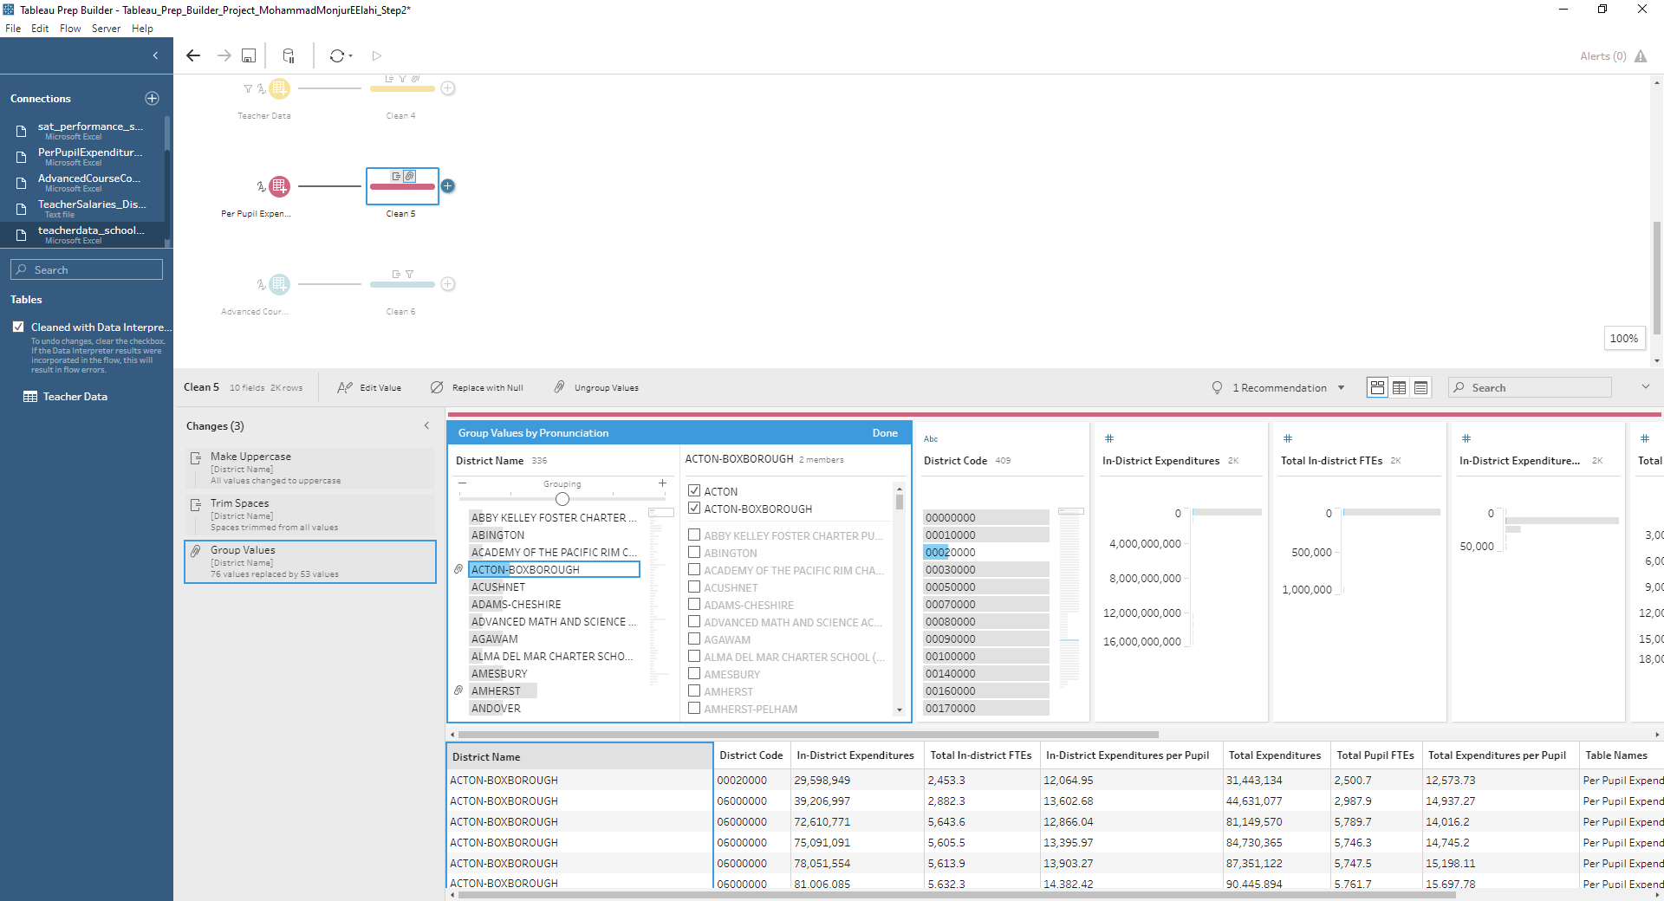
Automatic Grouping of District Names
1
2

Slide 18
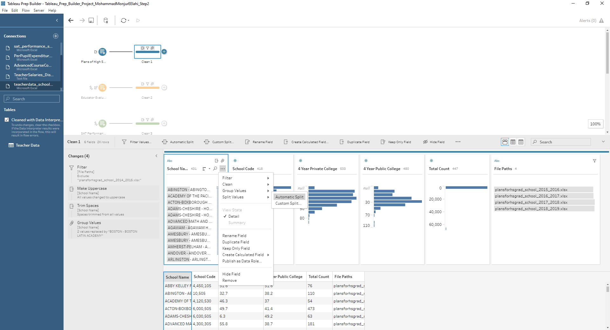
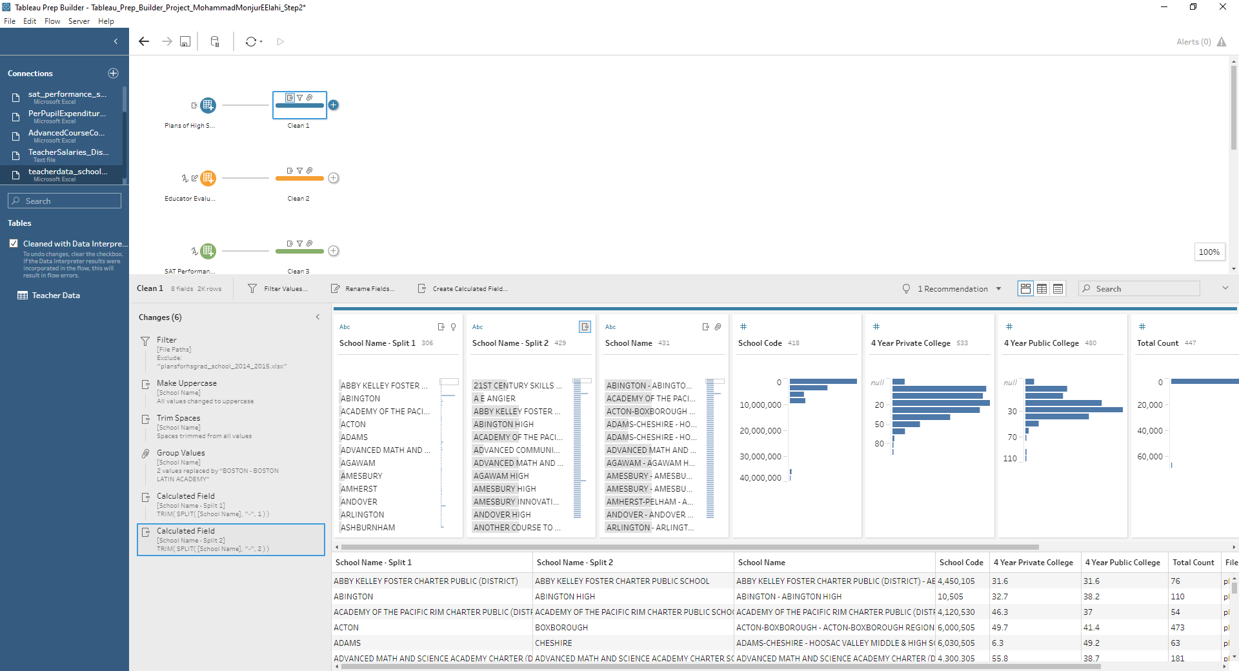
Automatic Split of School Name
1
2

Slide 19
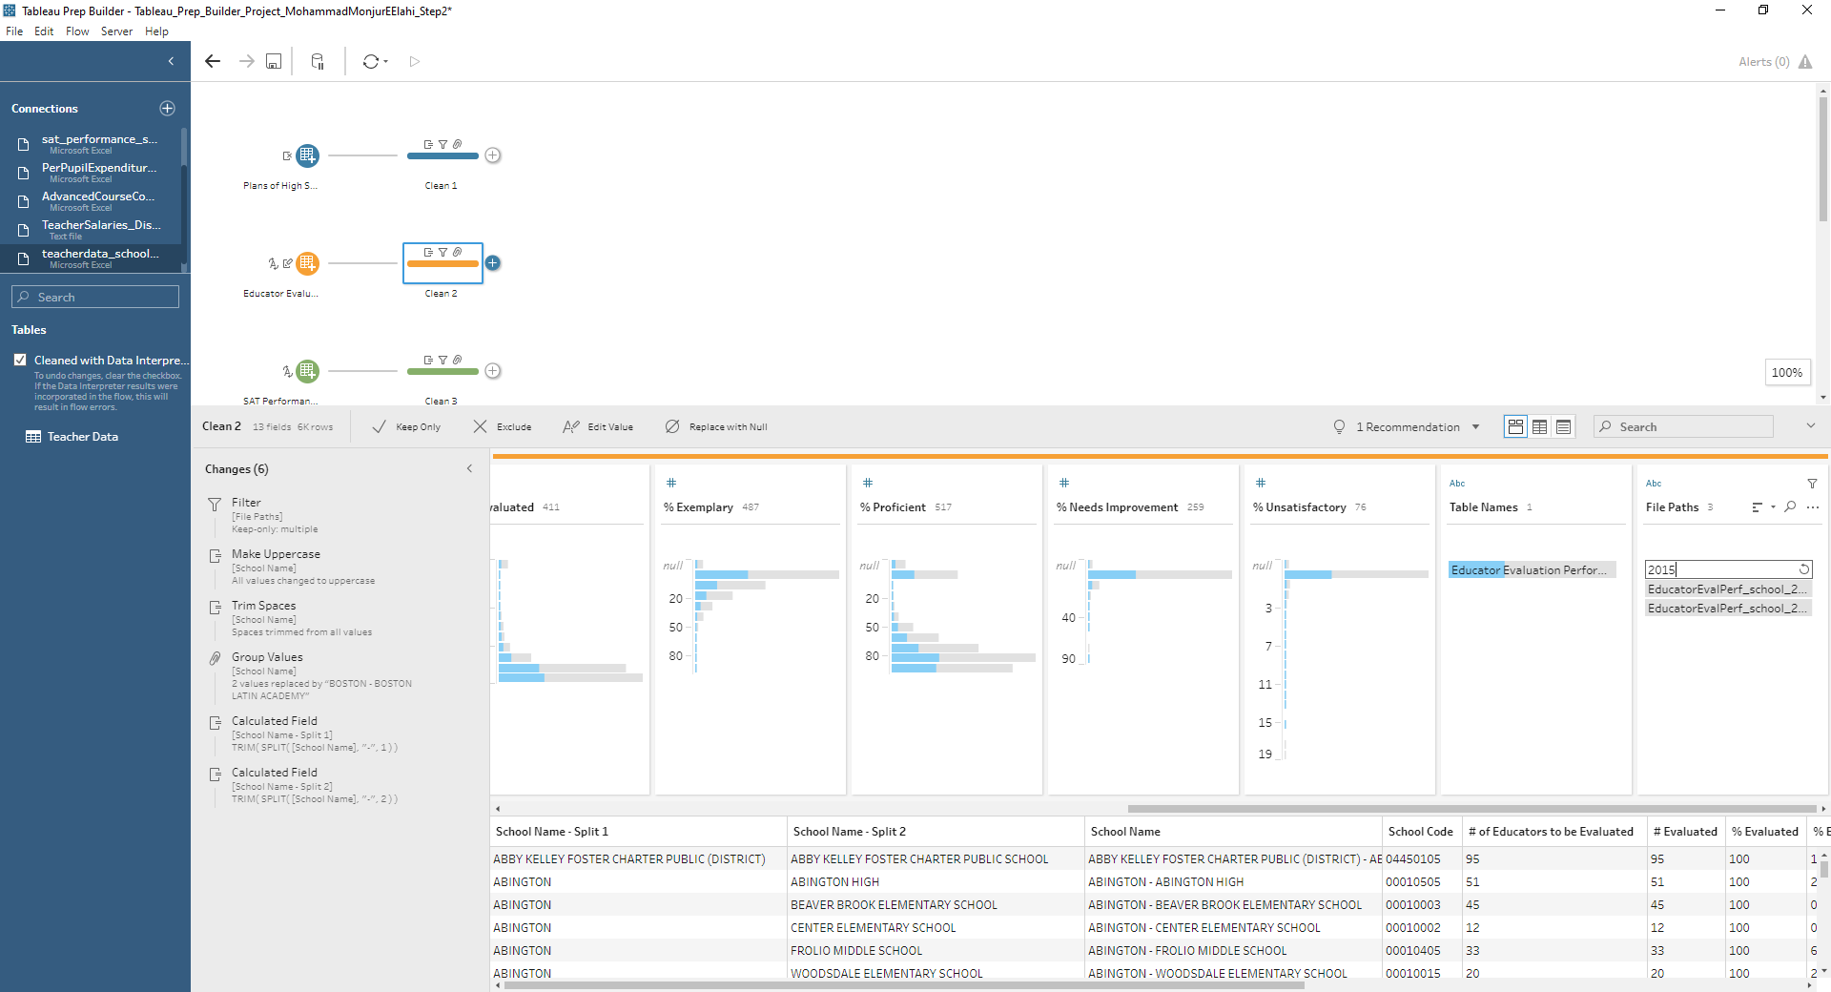
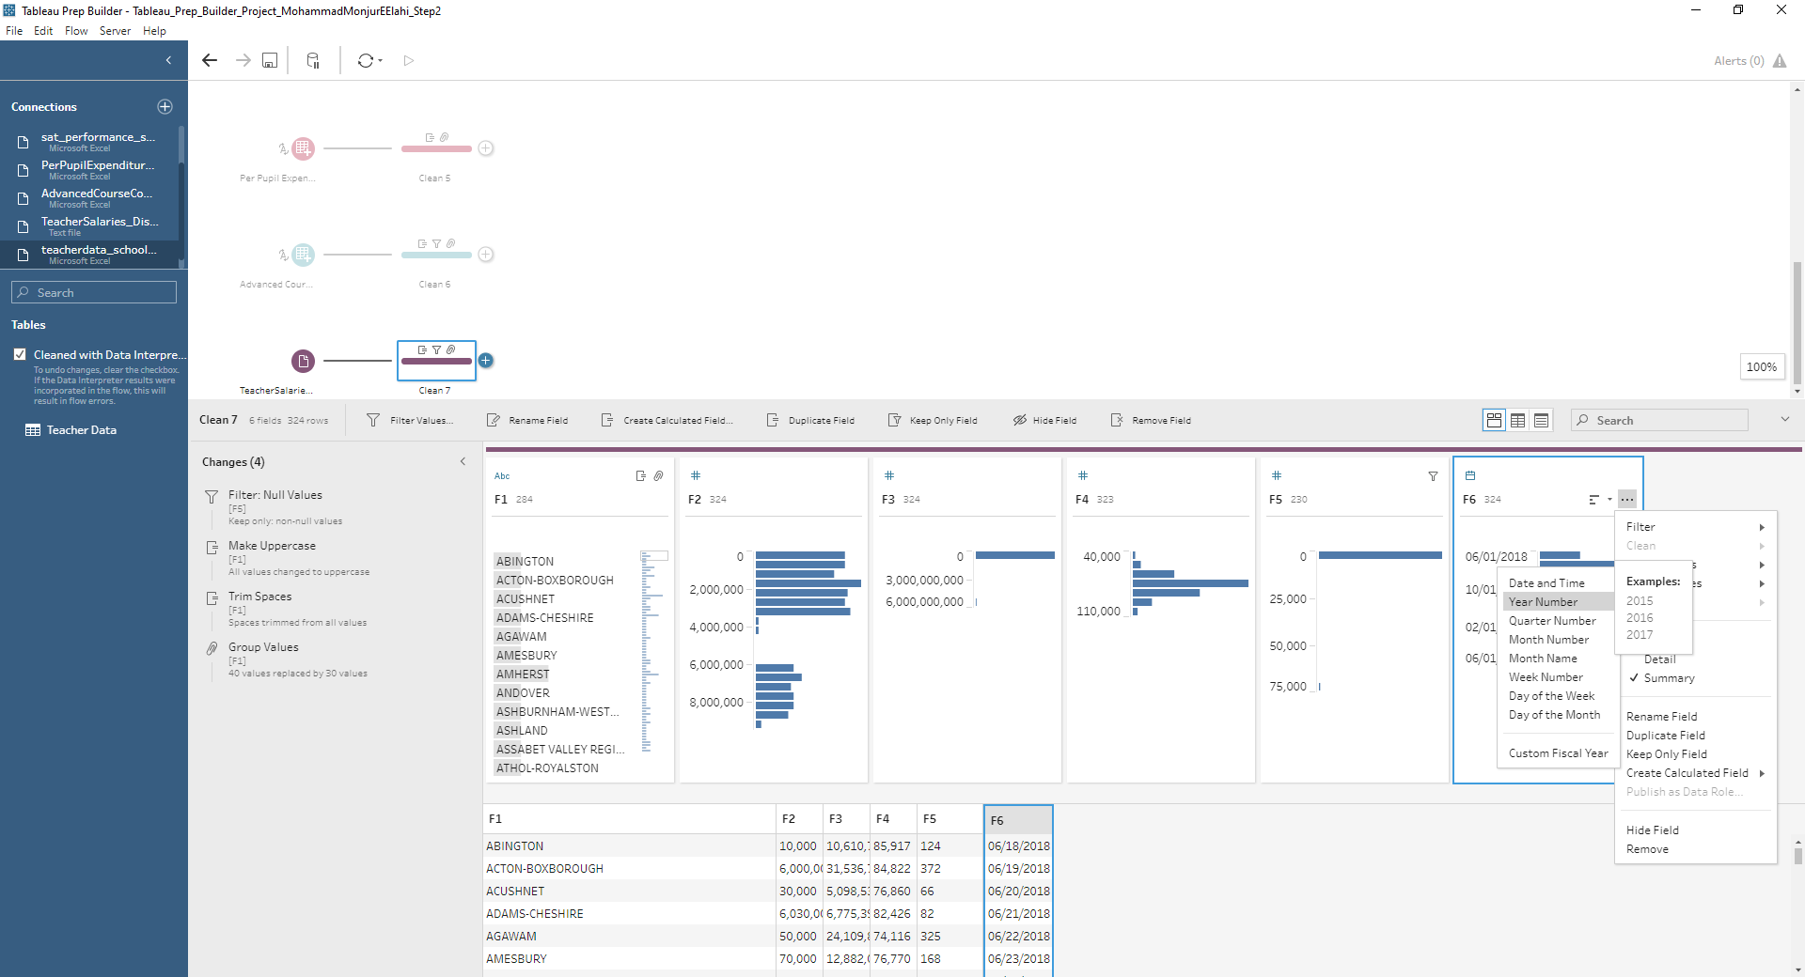
Changing Value of File Path and converting dates
1
2

Slide 20
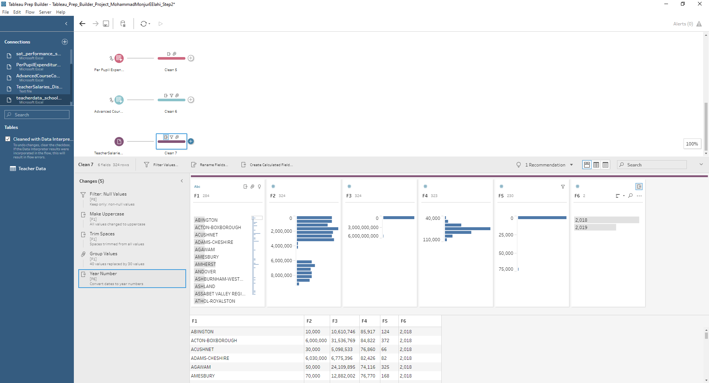
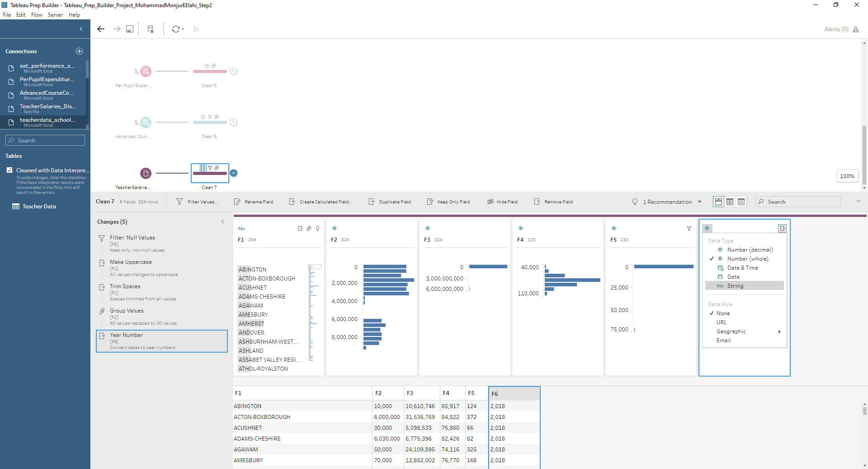
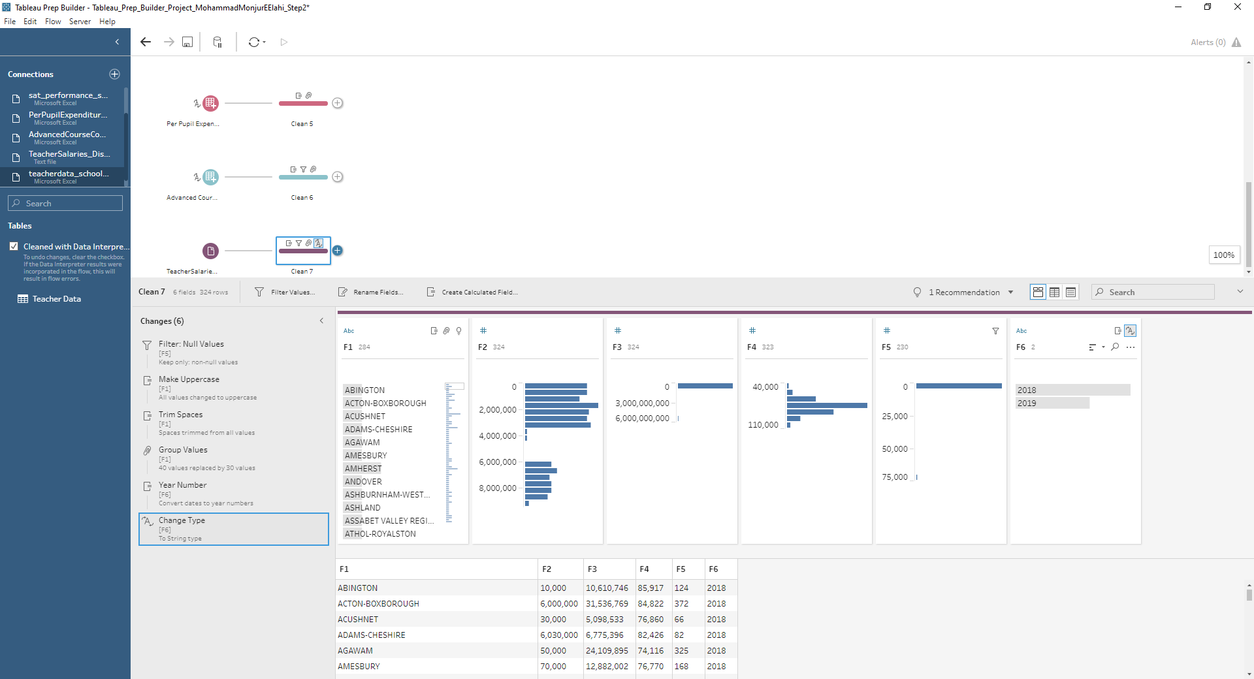
Converting to Dates and Data Type
1
2
3
4

Slide 21
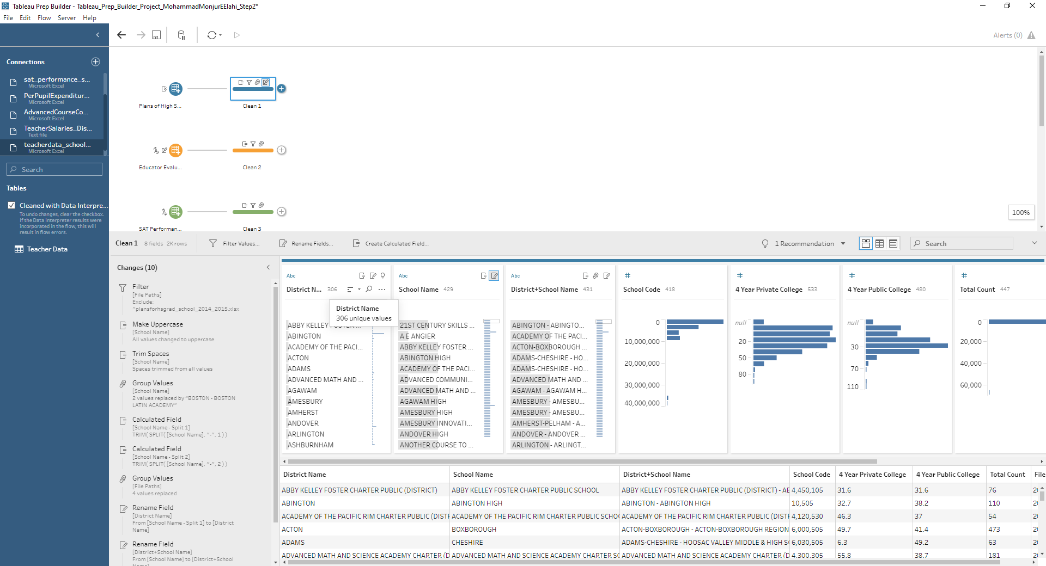
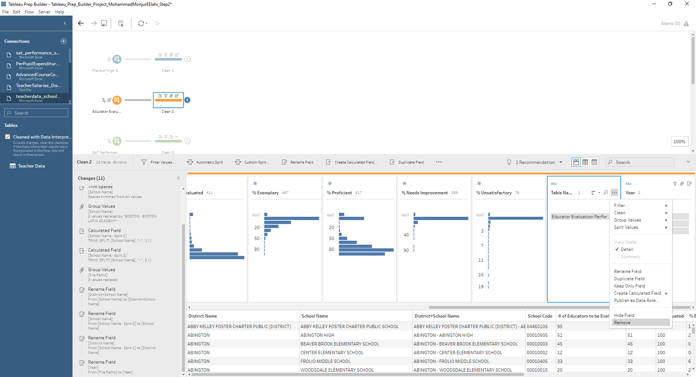
Updating Field Names and Removing Field
1
2
3

Slide 22
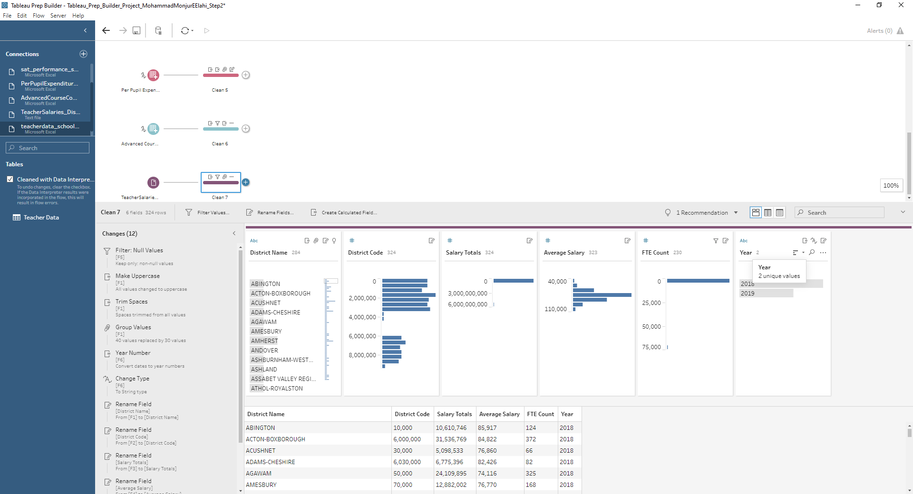
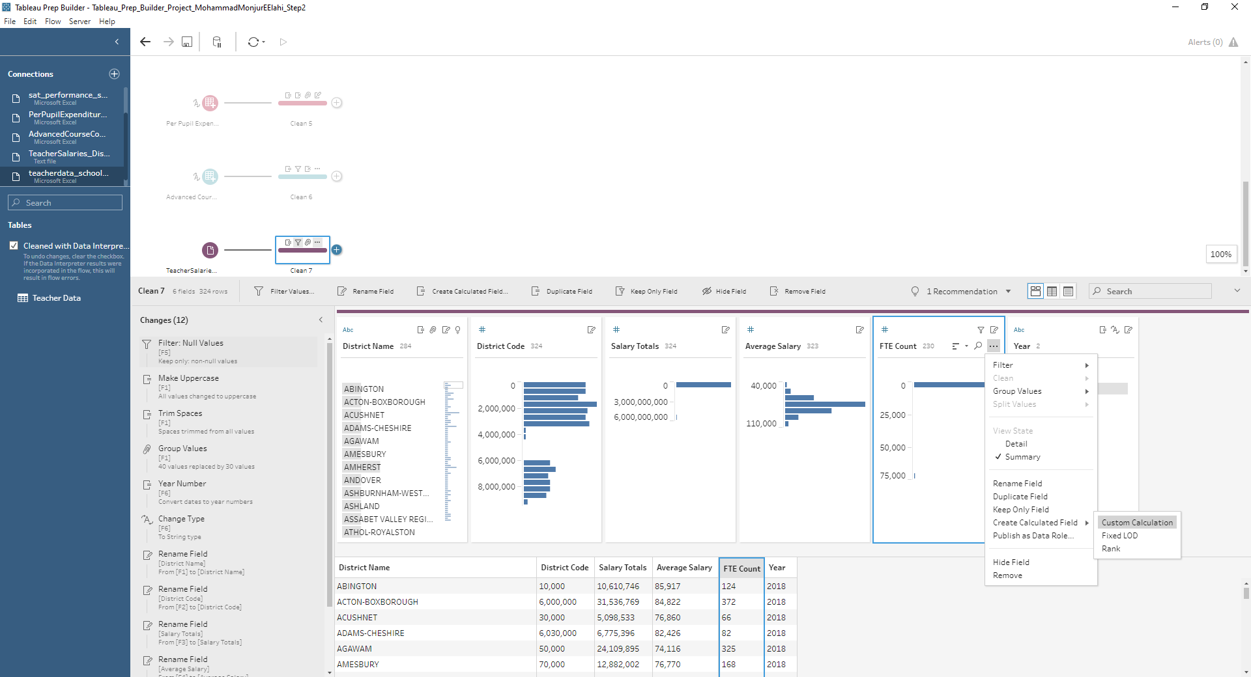
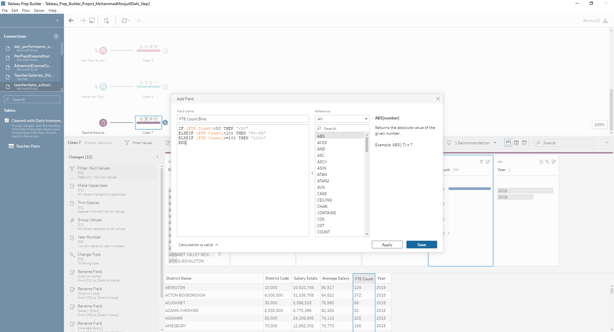
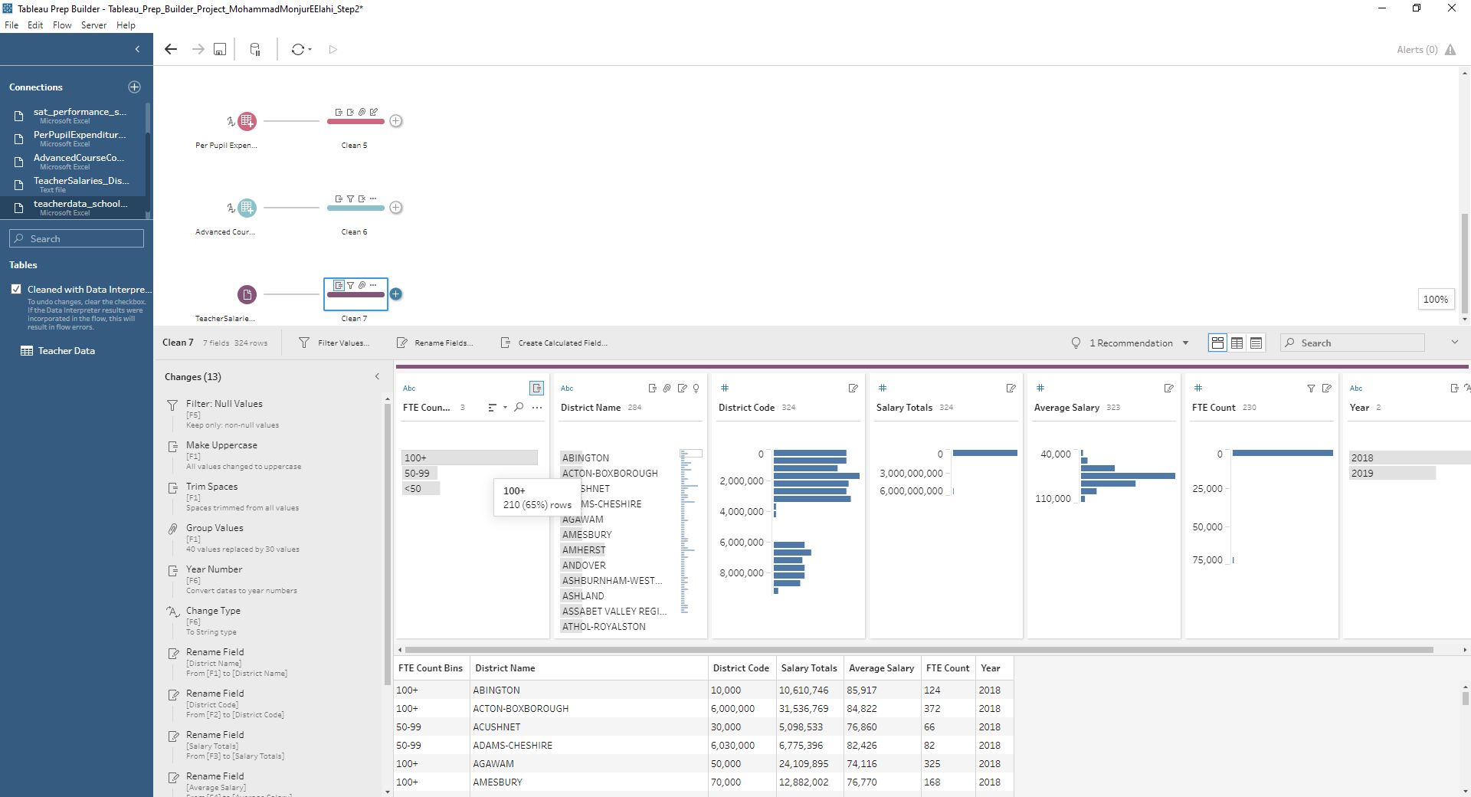
Change File Path to Date and Create Calculated Field to Segment
1
2
3
4
5

Slide 23
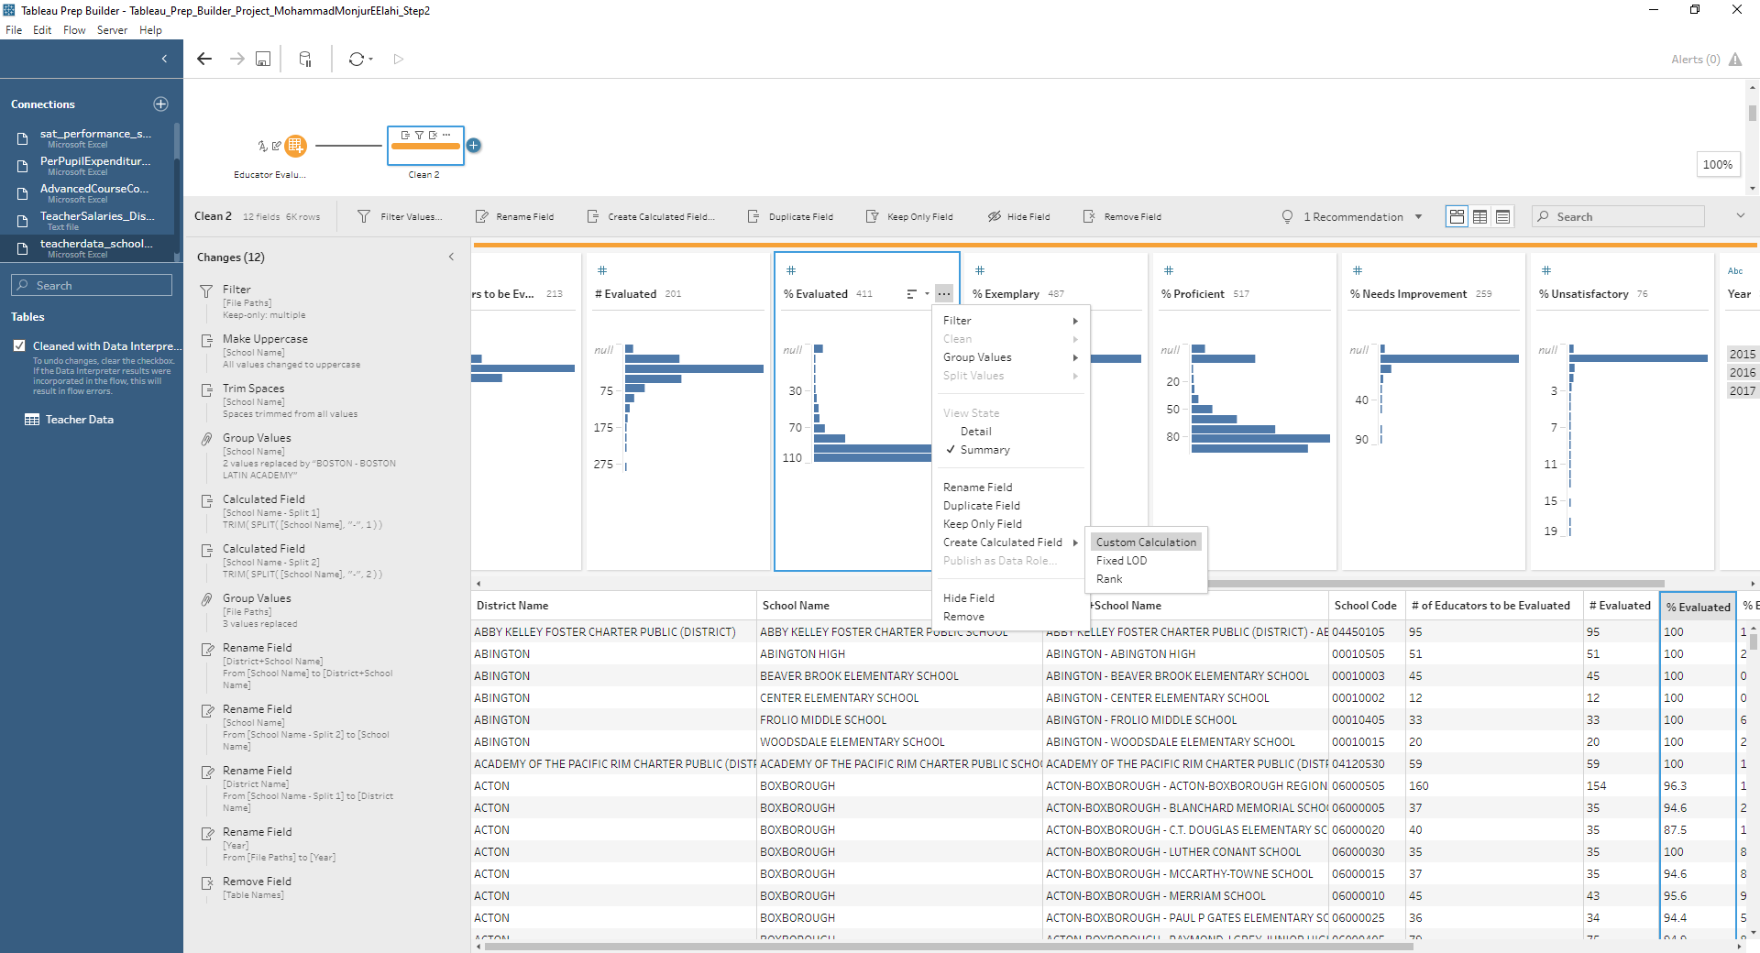
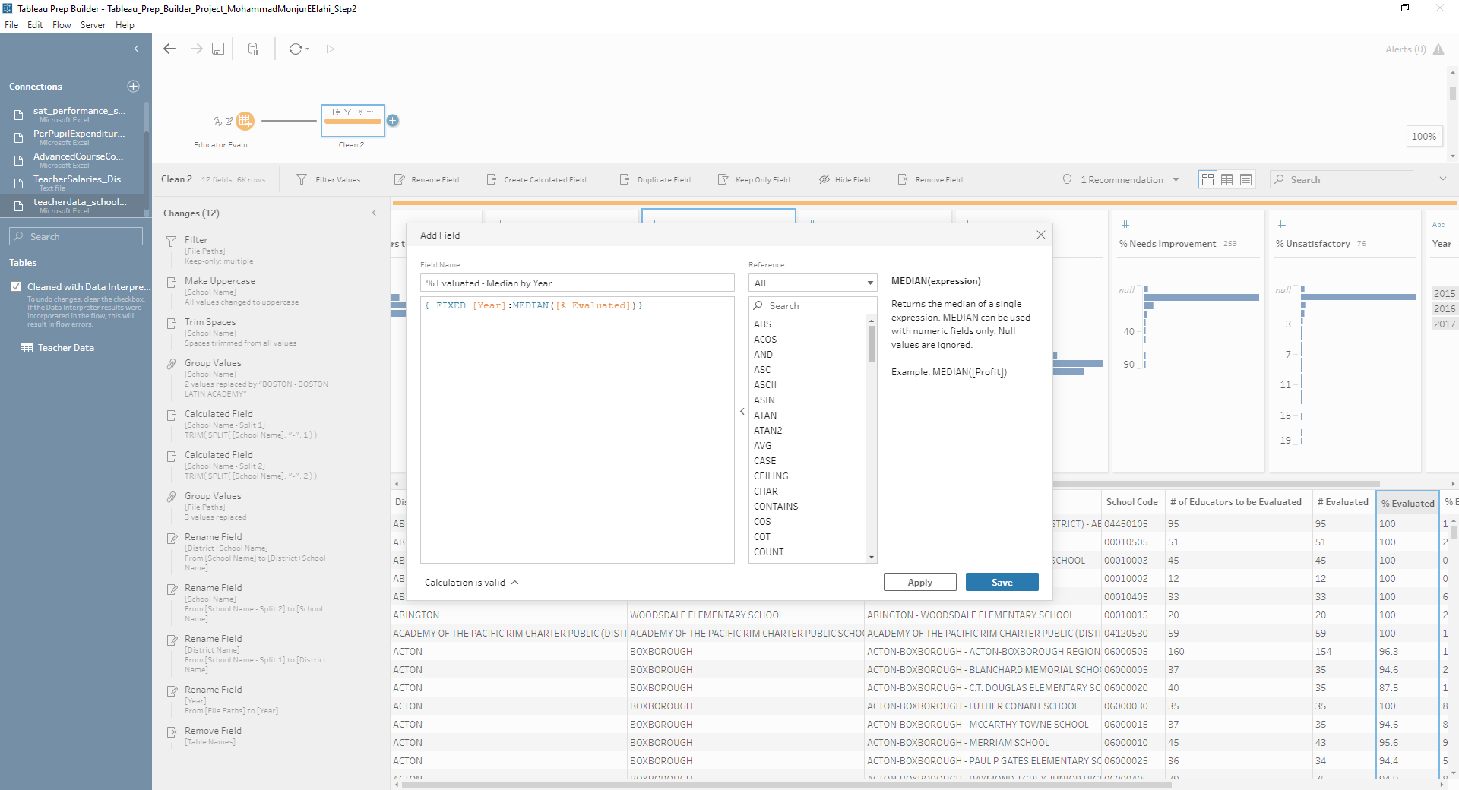
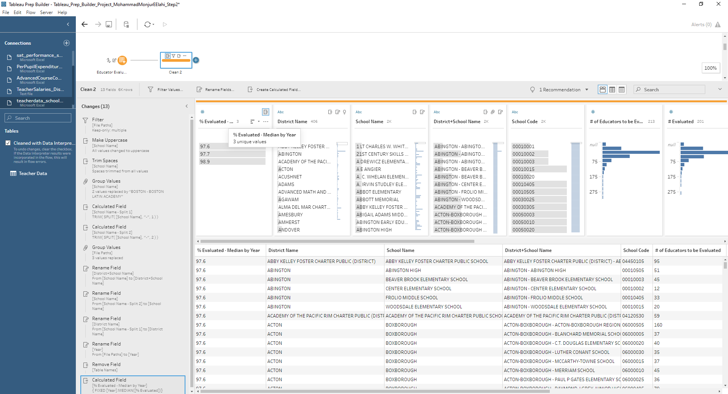
Level of Detail Calculations Manually
1
2
3

Slide 24
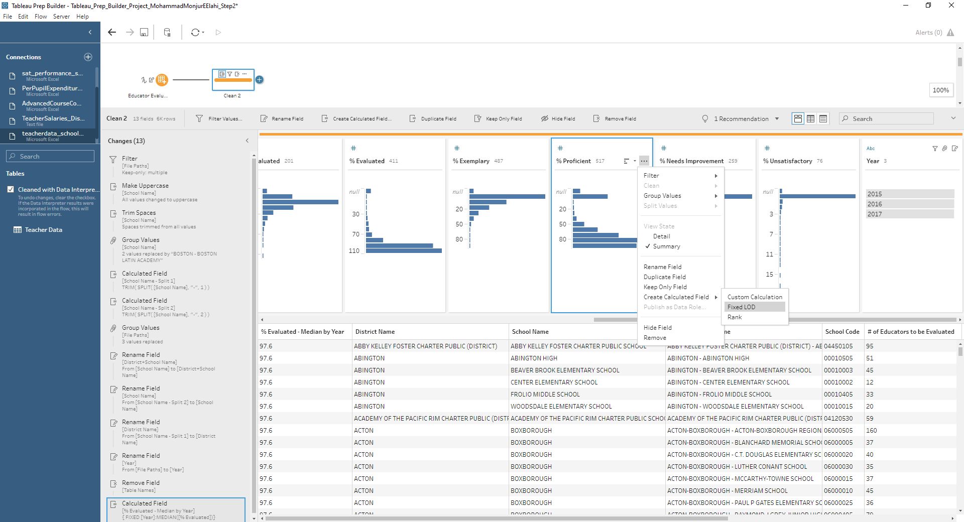
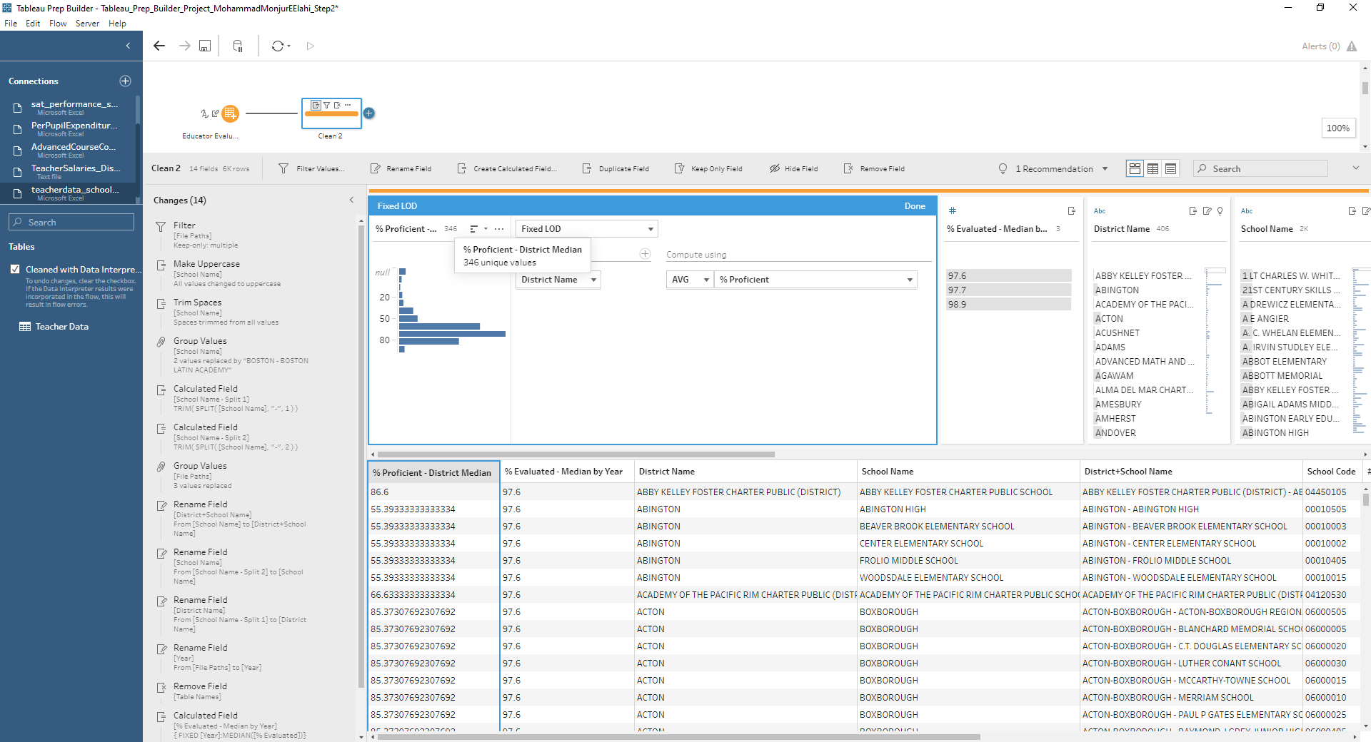
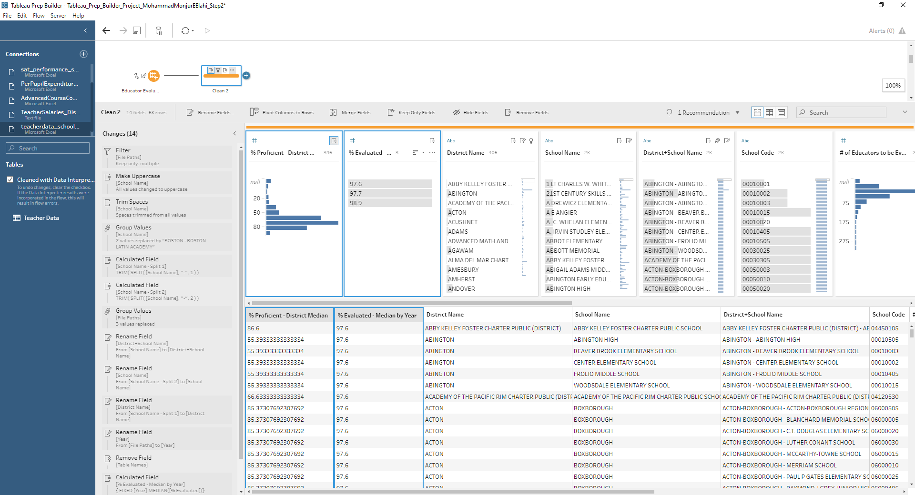
Level of Detail Calculations Using GUI
1
2
3
4

Slide 25
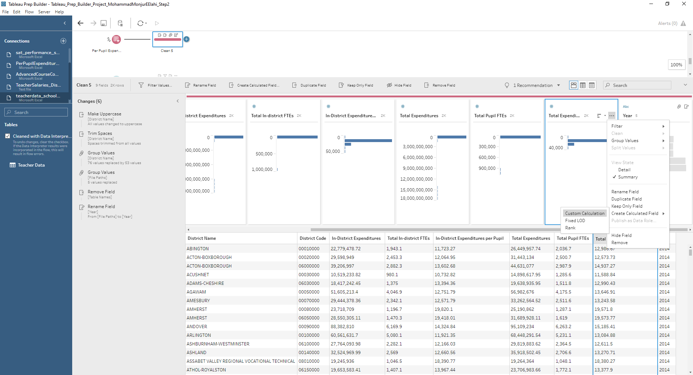
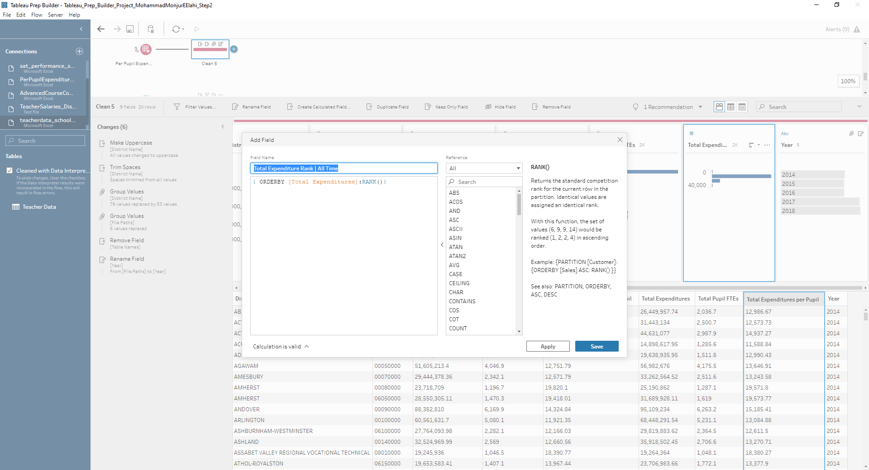
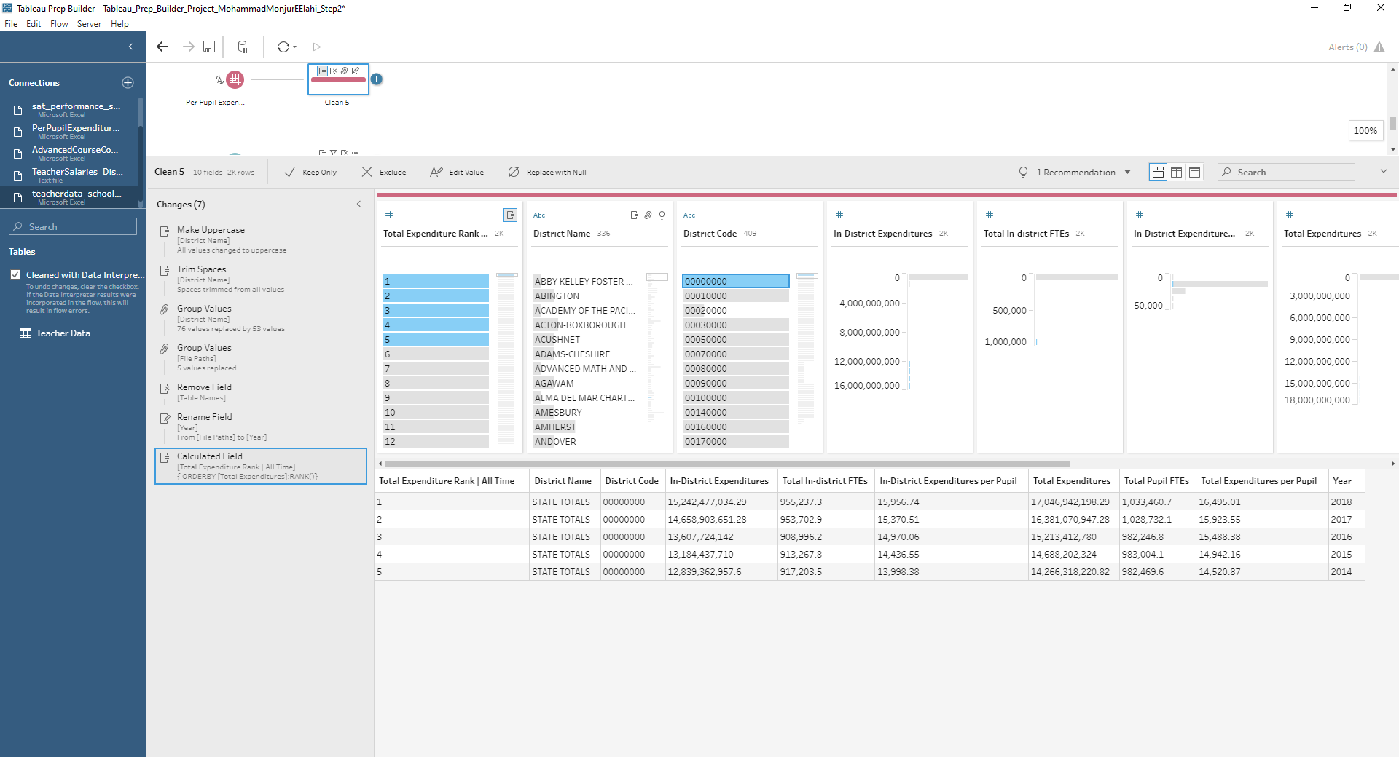
Analytic Calculations Rank Manually
1
2
3

Slide 26
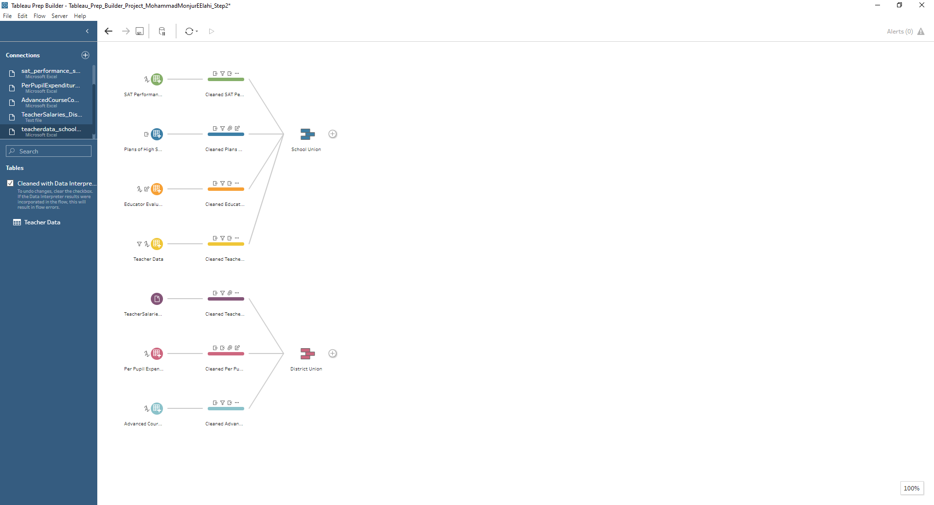
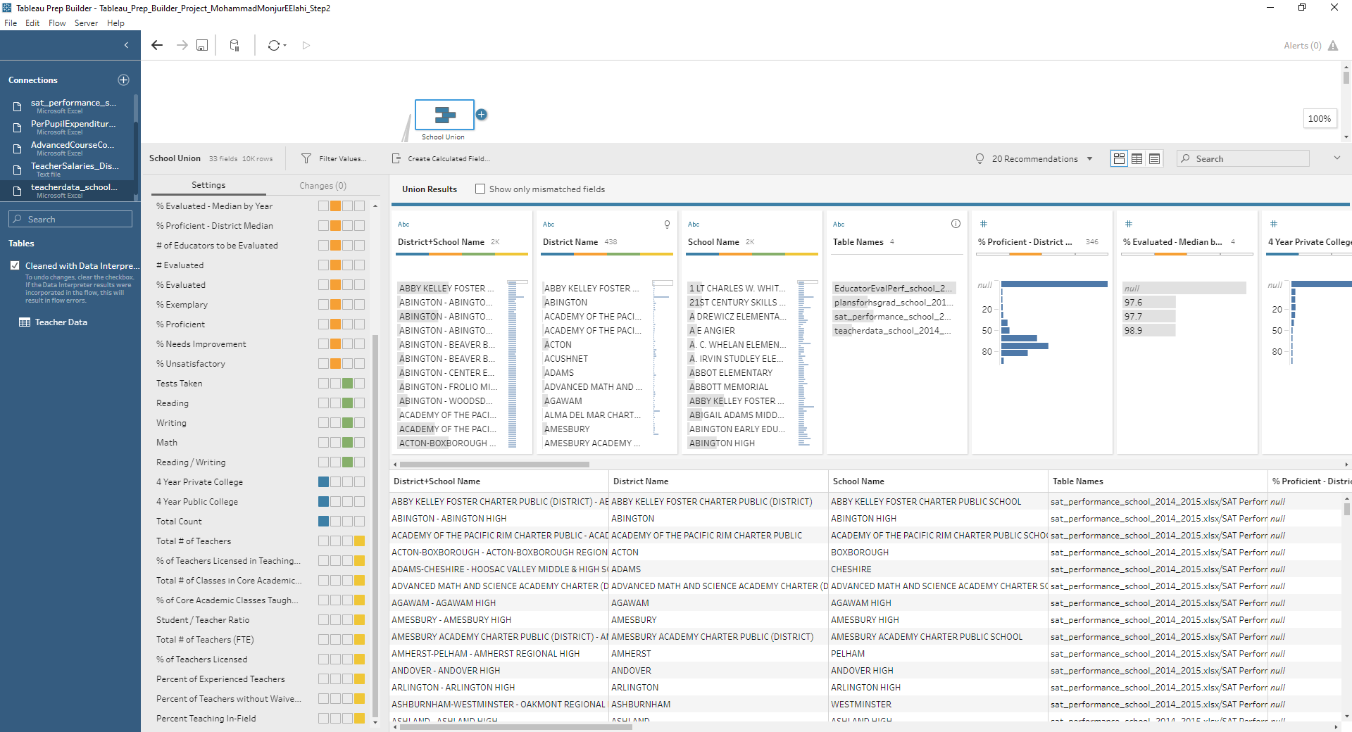

Unions of School and District Level Data: Mismatches are Logical
1
2
3

Slide 27



School Aggregate: District Name, District+School Name, School Name, School Code, Year
1
2
3

Slide 28

District Aggregate: District Name, District Code and Year

Slide 29

Aggregate Unique Schools and Districts

Slide 30

Joining to Unique Schools

Slide 31


Calculated Fields In Join
1
2

Slide 32


Branching Out Aggregate : Grouped Fields: District Name & Year
1
2

Slide 33

Joining to Unique District

Slide 34



Joining School to District Aggregate to Unique District Join
1
2

Slide 35

Joining School to District Aggregate to Unique District Join

Slide 36

Fixing Issues of Joins: Removing Duplicate Features

Slide 37


Fixing Issues of Joins: Data Type Mismatch
1
2

Slide 38

Fixing Issues of Joins Completed

Slide 39

Pivoting to transform wide data to vertical one

Slide 40

Pivoting: Selecting Pivoted Fields – Took all numeric fields

Slide 41

Pivoting: Changing Pivot Result Name

Slide 42


Exporting Package Flow File
1
2

Slide 43


Creating Local Extracts
1
2

Slide 44


Creating Local Extracts
1
2

Slide 45


Creating Local Extracts
1
2

Slide 46


Saving To External Database
1
2

Slide 47


Saving To External Database
1
2

Slide 48
Final Status of the Flow

Slide 49
Conclusion
Cleaned the dataset as per client’s requirements
Joined the School Level and District Level Data for Ease of analysis of the client
Shared outcome of the data preparation in several ways

Slide 50
The Project for Tableau Desktop
We’ve been given an excel file by an imaginary Retail Company to prepare:
1. Worksheet Depicting:
Sales vs Goals
Sales vs Sub-category
Top N Customer dynamically
Monthly Sales and Profit Trends
Map Sales vs Profit
Few Big Aggregated Number (Like Total Sales etc.)
2. Interactive Dashboard
3. Story Highlighting Few Aspects

Slide 51
I would Like to Show
Directly From
Tableau Desktop

Slide 52
Thanks
Questions ?

